Slide 1
HCSW New to Care
Alison Bardsley
Assistant Director for Pre and Post Registration Training
Alison.Bardsley@nhft.nhs.uk

Slide 2
Value Based Job Adverts and JD’s
Applications considered where candidates demonstrate drive and enthusiasm and the right values
NHFT provide training and supervision to support individuals to undertake the role
Through supervision and debriefing, individuals continuously learn from situations in order to deliver quality care and improve practice.

Slide 3
About you
Behaviours and Values | Knowledge and Experience
Compassionate and caring Confident, courageous Flexible Self-motivated. Non-judgemental. Positive attitude and enthusiastic Work in co-production with patients Commitment to supervision and learning | Essential: No previous experience necessary however you must be able to demonstrate drive and enthusiasm for working with this patient group. Desirable Previous experience working in a mental health setting.
Skills and Abilities
Able to work collaboratively within a team structure. Good communicator. Enjoys the pace of work and can work under pressure. Flexible with regard to shift work. Candidates must have the ability to work day shifts, night shifts and weekends and rotate across these shifts regularly Physically fit enough to complete PMVA training (Teamwork) and deliver the taught interventions Ability to remain calm during highly emotive situations

Slide 4
Widening Participation Pathways - NHFT
Work Experience
Programmes
Joining NHFT’s Volunteer To Career Pathways
Prepare to Care clinical training
Joining Staff Bank
Applying for an Apprenticeship
Substantive Appointment and Career Progression
Clinical Apprenticeships

Slide 5
Partnership working Indeed and The Princes Trust
Support with application and interview preparation
Identify potential candidates (jobs posted on Indeed as well as NHS jobs)
Shortened application process through Indeed
Indeed provide an initial screening interview (candidates can be signposted to The Princes Trust for additional support)
Clinical Teams have input with short listing and interview
Successful candidates with no previous healthcare experience access the Prepare to Care programme
Those who are unsuccessful are signposted to The Princes Trust (where eligible) for additional support or to the Volunteer to Career pathway
Notes:
Princes Trust up to 30 years old – work with young people
New Indeed process is shortened and available through mobile devices which the NHS website is not

Slide 6
Notes:
Also working with St Johns Ambulance NHS cadets

Slide 8
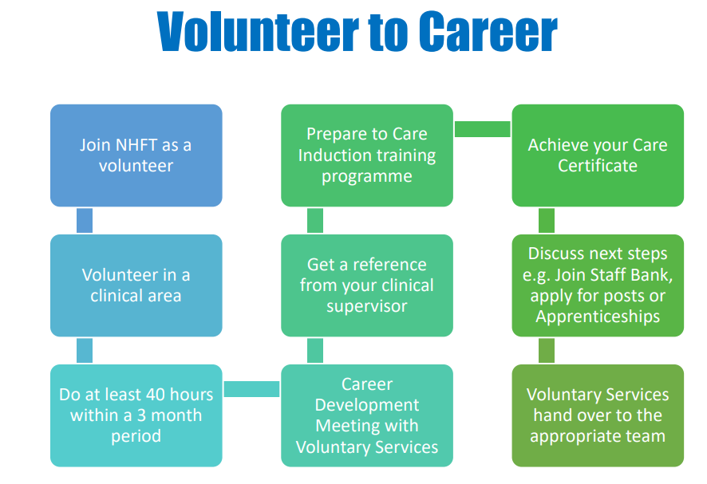

Slide 9
Prepare to Care
Notes:
The Care Certificate is an agreed set of standards that define the knowledge, skills and behaviours expected of specific job roles in the health and social care sectors. It's made up of the 15 minimum standards that should be covered if you are 'new to care' and should form part of a robust induction programme.’(Skills for Health, 2021)
Functional Skills
Where applicants are required to undertake functional skills an initial assessment will be required prior to sign-up. Should the applicant not achieve the required level from the initial assessment they will be required to undertake the functional skills first outside of the apprenticeship. This is to mitigate non-achievers of the apprenticeship programme which may lead to the provider having the programme withdrawn from their offerings should their pass rate fall.
NHFT also support this by offering functional skills up-front prior to joining the apprenticeship programme. A further advantage to this is that the new apprentices only focuses on the apprenticeship standard going forward.
Level 2 apprenticeships – require level 1 functional skills with a further option to take level 2
Level 3 and above apprenticeships – require level 2 functional skills

Slide 10
Direct Hire New to Care cohort recruitment plan
First 6 weeks of employment contract sits within the corporate Nursing Directorate
Weeks 1-2
Care Certificate and Prepare to Care
Weeks 3-4
Simulated Clinical Learning and Clinical Mandatory Training
Weeks 5-6
Deployment and supernumerary induction into clinical team
Week 7
Substantive into their new team and service Line budget
Continued support provided by practice education team
End of 12 weeks
Care Certificate sign off
Continued Preceptorship provided for 6mths
Probationary period sign off
Notes:
We already have Short-term targeted HCSW recruitment via the introduction of a rolling cohort approach into outstanding posts across NHFT operational services. over a 12-month period.
This project will provide
Delivery of a 6 week on-boarding ‘Prepare to Care’ programme to include mandatory training and simulated experience before deployment to strengthen retention (particularly for HCSW’s who are new into healthcare)
Growth, recognition, and development of the non-registered workforce
Enable the development of a pipeline for career progression opportunities into Higher Clinical Apprenticeships; Registered Nursing Associate and Registered Nurse Degree Apprenticeship.

Slide 11
Direct Hire New to Care cohort recruitment plan
NHFT already have Short-term targeted HCSW recruitment via the introduction of a rolling cohort approach into outstanding posts across NHFT operational services. over a 12-month period.
This project will provide
Delivery of a 6 week on-boarding ‘Prepare to Care’ programme to include mandatory training and simulated experience before deployment to strengthen retention (particularly for HCSW’s who are new into healthcare)
Growth, recognition, and development of the non-registered workforce
Enable the development of a pipeline for career progression opportunities into Higher Clinical Apprenticeships; Registered Nursing Associate and Registered Nurse Degree Apprenticeship.

Slide 12
Direct Hire Apprenticeship
Behaviours and Values | Knowledge and Experience
Approachable, have a calm and patient manner and be a team player. Smart in appearance. Ability to work in a flexible way and respond to change. Able to deal with interruptions and be able to multi-task. Be respectful and supportive of others. | Educated to GCSE or equivalent. Knowledge of the NHS is desirable not essential.
Skills and Abilities
This is an developmental role therefore being able to demonstrate these skills would be desirable: Have good time management and organisational skills Excellent interpersonal skills and the ability to utilise them to communicate effectively with patients and within a multi- disciplinary team. Ability to work in a busy, sometimes pressurised environment. | Working to deadlines. Ability to deal with people at all levels within an organisation. Ability to prioritise and work on your own and in a team environment. Ability to think ahead / use initiative. Confident in seeking help.
Notes:
Functional Skills
I will add however that where applicants are required to undertake functional skills an initial assessment will be required prior to sign-up. Should the applicant not achieve the required level from the initial assessment they will be required to undertake the functional skills first outside of the apprenticeship. This is to mitigate non-achievers of the apprenticeship programme which may lead to the provider having the programme withdrawn from their offerings should their pass rate fall.
NHFT also support this by offering functional skills up-front prior to joining the apprenticeship programme. A further advantage to this is that the new apprentices only focuses on the apprenticeship standard going forward.
Level 2 apprenticeships – require level 1 functional skills with a further option to take level 2
Level 3 and above apprenticeships – require level 2 functional skills

Slide 13
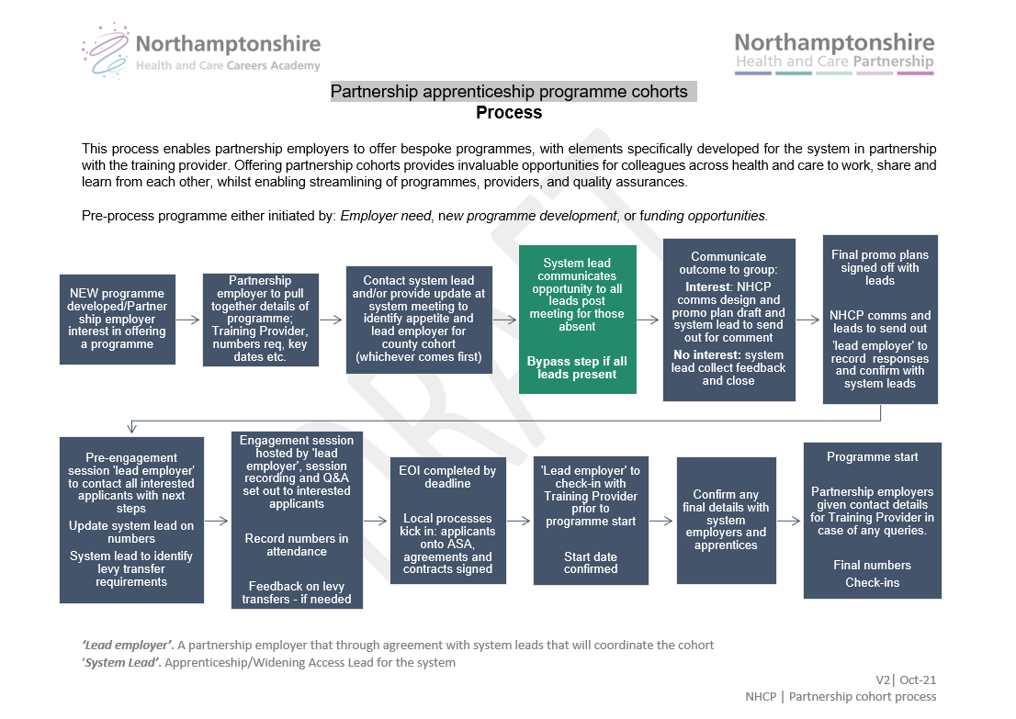
TITLE GOES HERE
Content goes here

Slide 14
OUR VISION
To be a leading provider of outstanding, compassionate care
We will achieve this via our strategy DIGBQ:
Developing in partnership
Innovation
Growing our staff capability
Building a sustainable organisation
Quality and safety at the foundation of all we do.
Notes:
Internal use only

