Slide 1
The ageing workforce -
responding to the challenge

Slide 2
Content of the presentation
Background - changing demographics
Pension changes – the economic and NHS context
The NHS Working Longer Group
Raising awareness of the ageing workforce

Slide 3
Background
Changing demographics and the context of an ageing workforce

Slide 4
Demographics of the current NHS workforce
The average age of NHS staff is 43¹
It is projected to rise to 47 by 2023 ²
With over half of the NHS population over 40 years old and a third over 50, the NHS workforce is ageing ².
Average of data from HSCIC (England)
In the UK. The NHSWLG preliminary findings and recommendations report

Slide 5
Demographics of the current Health & Social Care workforce (March 2015) – Northern Ireland
The average age of N. Ireland HSC staff is 43.0. ¹
With 61% of the HSC workforce over 40 years old and 32% over 50, the HSC workforce is ageing.
However, Medical & Dental and Professional & Technical staff tend to be younger- 55% under 40.
1. HSC data (Northern Ireland), March 2015

Slide 6
“Older people are going to have to stay economically active longer ...........and that is going to require not just governments, but also employers and workers to behave differently.”
Economist, April 2011

Slide 7
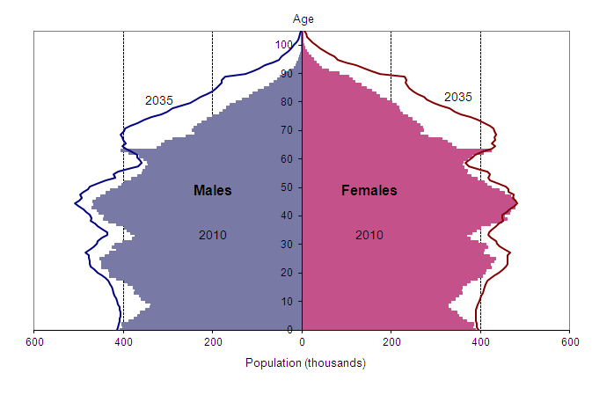
Demographics of the population
The diagram below shows the distribution of the population in 2010
and predicted in 2035
Office for National Statistics (UK population figures)

Slide 8
Demographics of the population in Northern Ireland
The diagram below shows the distribution of the Northern Ireland population in 2015 and predicted in 2035.
Based on NISRA 2012 projections

Slide 9
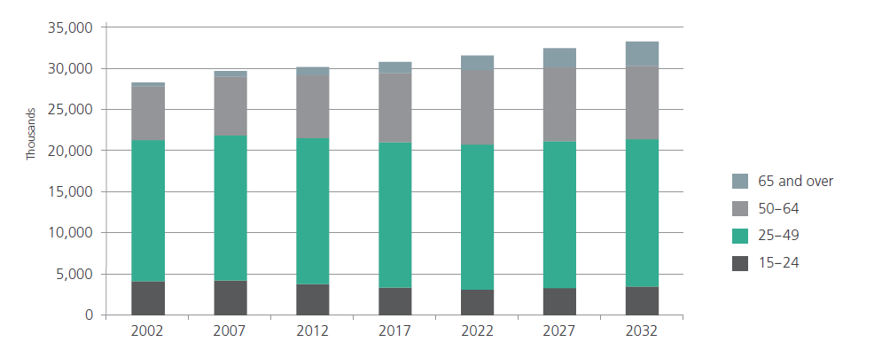
Age structure of UK employment
The diagram below shows the actual and illustrative projected age structure of UK employment between 2002-2032
Office for National Statistics (UK)

Slide 10
Age profile of the workforce in Northern Ireland

Slide 11
Age profile of your workforce
Insert your age profile/organisational workforce profile

Slide 12
Employing older workers
Reducing the
outflow of older workers could help employers reduce inefficiencies associated with filling vacancies and training new staff
700,000 fewer people aged 16-49 over the next 10 years¹
‘early exit is bad for employers’
Older people
(50+) as a proportion of the working age population will increase to 32% per cent by 2020 compared to 26 per cent now¹
3.7 million more people aged 50 over next 10 years¹
Need to retain valuable
skills and experience
1 Office for National Statistics (UK population figures)

Slide 13
Pension changes
The economic context and impact on the NHS

Slide 14

State pension age increases
In the 2015 NHS Pension Scheme members now have a normal pension age (NPA) that is the same as their SPA.
This means that when the SPA increases, an individuals NPA will automatically increase too, so that the age at which they can access an unreduced occupational NHS pension will be their SPA.

Slide 15
State pension age increases
Up to 95 per cent of the NHS workforce will now have a pension age of between
65 and 68
HSCIC data September 2015, England and Wales
    The pension age will increase again in the future as the Government raises the SPA further
    Members of the 2015 NHS Pension Scheme, England and Wales

Slide 16
State pension age increases in Northern Ireland
Over 97 per cent of the current HSC workforce will have a state pension age of between 65 and 68
HSC (Northern Ireland), March 2015
    The pension age will increase again in the future as the Government raises the SPA further

Slide 17
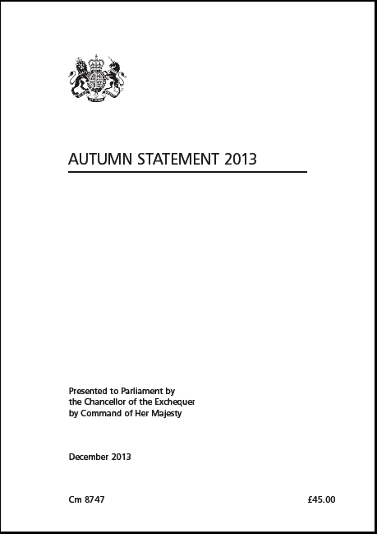
State pension age increases
‘We think a fair principle is that, as now, people should expect to spend up to a third of their adult life* in retirement. Based on latest life expectancy figures, applying that principle would mean an increase in the state pension age to 68 in the mid 2030s and to 69 in the late 2040s’
George Osborne, Chancellor of the Exchequer Autumn Statement 5th December 2013
* post 18 years of age

Slide 18
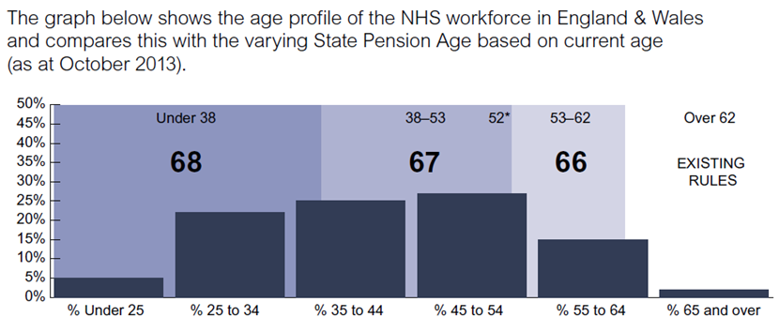
Profile of the NHS workforce and the state pension ages
Source: Changes to the state pension and data from the Electronic Staff Record (ESR) data warehouse.

Slide 19
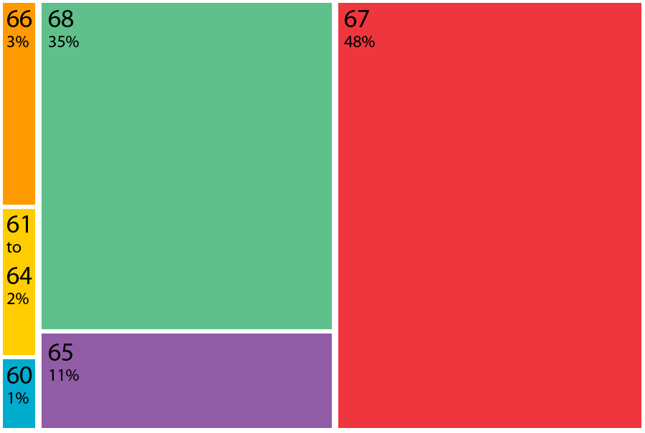
Profile of the HSC workforce in Northern Ireland by state pension ages
As at 31 March 2015. Note that those who reached state pension age at 60, 61 or 62 are already receiving it, and continuing to work for the HSC.
Source: DHSSPS/NI HSC HRPTS. Excludes domiciliary care.

Slide 20

The NHS Pension Scheme
The NHS Pension Scheme has three elements:
The 2015 Scheme
career average revalued earnings (CARE) scheme
normal pension age linked to State Pension Age.
The 2008 section
final salary scheme
normal pension age defined by scheme rules
The 1995 section
final salary scheme
normal pension age defined by scheme rules

Slide 21
The 2015 NHS Pension Scheme
The 2015 scheme was implemented 1 April 2015. Features of the scheme include:
A move to a career average earnings (CARE) scheme rather than final salary for pension benefits earned
An accrual rate of 1/54th of pensionable earnings each year with no limit on pensionable service
Pensionable earnings increased in line with CPI plus 1.5 per cent.
A NPA equal to SPA (active and deferred members)
Average member contributions of 9.8 per cent with tiered contributions
Options to pay additional contributions to fund early retirement.
Protection – full, tapered and no protection.

Slide 22
Structural issues with multiple levels of entitlement across the workforce
Staff with special class status – NPA 55*
Mental Health Officer status – NPA 55*
1995 section members with protection – NPA 60
2008 section members with protection – NPA 65
New scheme members – NPA equal to SPA 67+
* Only staff with the status prior to 06/03/1995

Slide 23
Other pension and reward changes
Consider the issue of an ageing workforce for your organisation in the context of other changes the NHS has seen including lifetime and annual allowance, automatic enrolment and contribution increases.
Further detail about the NHS Pension Scheme can be found at www.nhsemployers.org/pensions.

Slide 24
The Working Longer Group
Purpose, membership, findings and objectives

Slide 25
Purpose of the group
A partnership group established in 2012.
The group is considering the impact of a raised retirement age on the NHS workforce.
The group submitted 11 recommendations as part of the preliminary findings report to the health departments.
The groups has been formally commissioned by the health departments to undertake specific pieces of work.
Task and finish groups have been established to deliver specific pieces of work, including a range of products for use across the NHS workforce.

Slide 26
Membership
Four country, tripartite partnership group
Employers in the NHS
Trade unions
Health Departments

Slide 27
Themes
The group made 11 recommendations as part of its preliminary findings report which concentrated on four main themes:
Occupational health and wellbeing
Pension information
Data collection
Work arrangements & environment

Slide 28
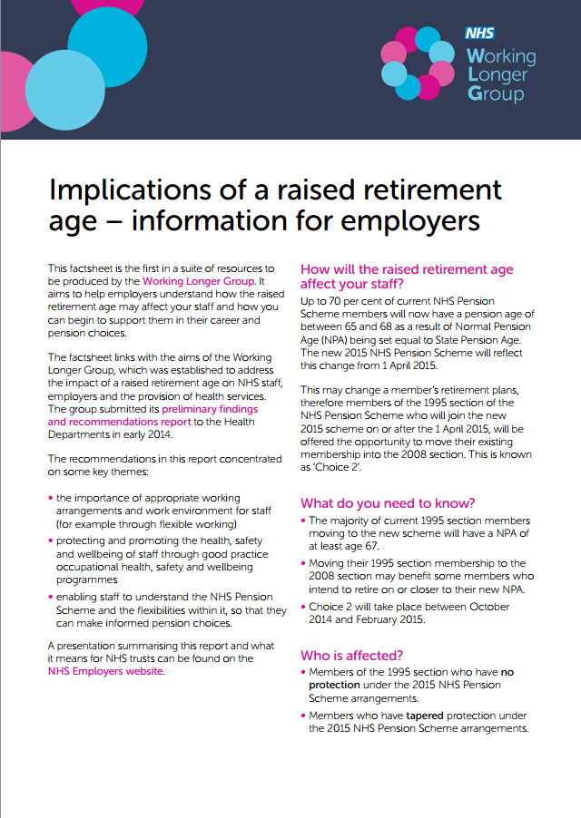
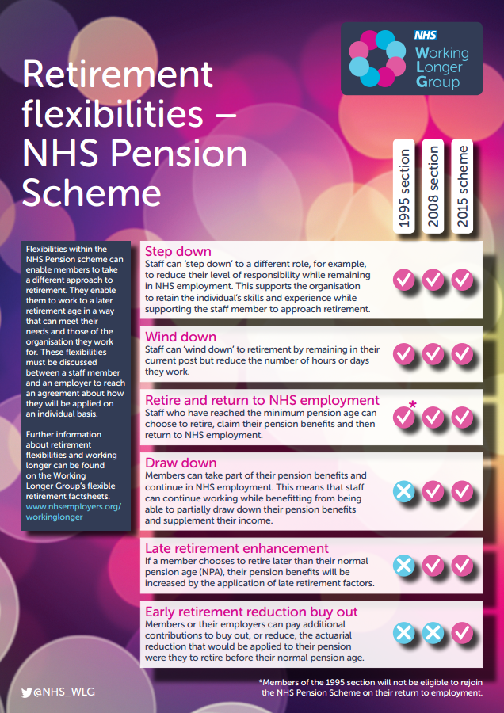
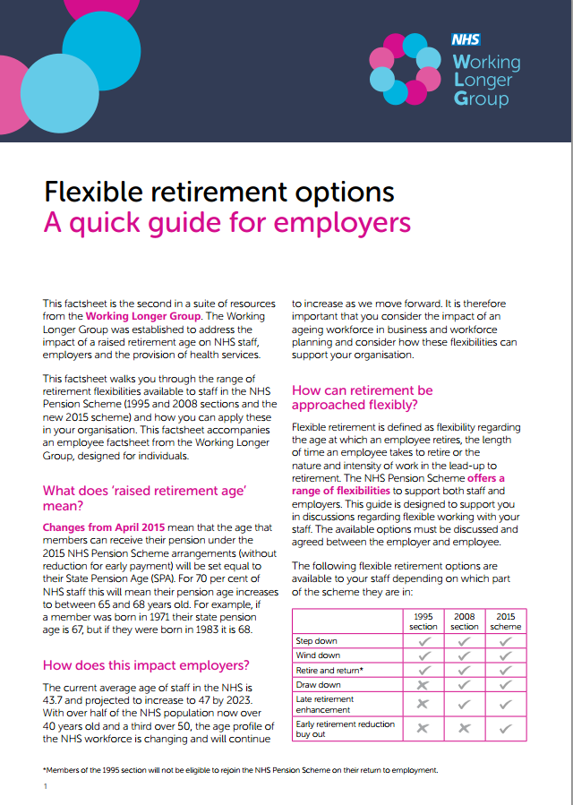
Products developed by the group
www.nhsemployers.org/WLGtoolsandresources

Slide 29

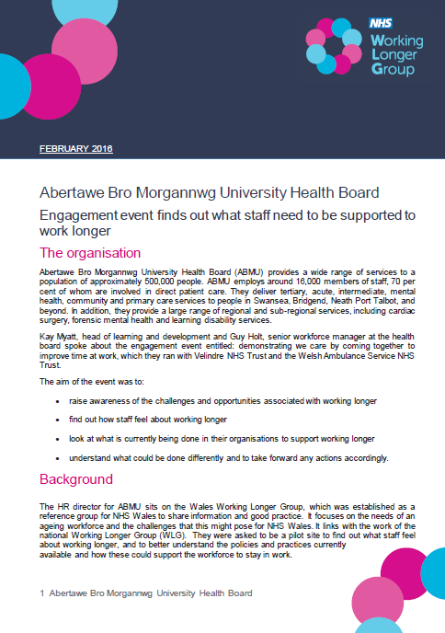
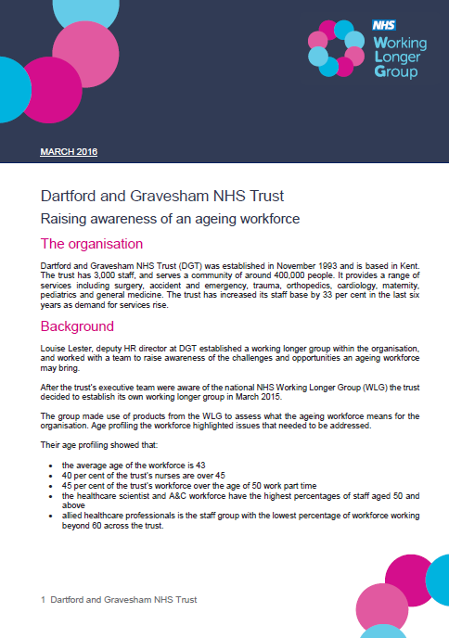
Products developed by the group
www.nhsemployers.org/WLGtoolsandresources

Slide 30
Raising awareness of the ageing workforce
What should we be doing now?

Slide 31
Raising awareness of an ageing workforce
Signpost to relevant information for staff
Review current processes in place to support an ageing workforce
Factor workforce demographic changes into workforce planning
Get involved with the work of the WLG
Raise awareness of the work and products of the WLG
Encourage use of redeployment as a normal option
Profile the age of your workforce

Slide 32
Any questions?
Discussion and debate

Slide 33


Thank you
@NHS_WLG
workinglongergroup@nhsemployers.org
www.nhsemployers.org/wlg

