Slide 1
Using flexible retirement to support retention
Rachel Jones, Head of Pensions, NHS Employers
Notes:
[Rachel 10:25-10:35]

Slide 2
Retire and Return v Partial Retirement
Retire and Retirement
Members must leave employment.
Re-employed on a new contract of employment.
Members must take all benefits at once.
Until 1 October, retire and return the only route for 1995 section members to access benefits in and continue to work in the NHS.
Option to join 2015 Scheme
Partial Retirement
Member can continue to work whilst taking pension benefits.
Contract of employment continues unchanged BUT – an opportunity to discuss flexible working.
Members can take some or all of their pension.
Option to join 2015 Scheme.
Seamless, supports gradual transition from working life to retirement.
Notes:
[Rachel 10:25 – 10:35]

Slide 3
Breaks in Service
Partial Retirement
Retire and Return
No break in service needed
24-hour break
Always required under scheme regulations
2-week break?
Optional - Only required if employer wishes to break continuous service
Notes:
[Rachel 10:25 – 10:35]

Slide 4
Achieving 10 per cent reduction in pensionable pay
Open discussions will be key to agreeing the necessary contractual changes to reduce pensionable pay.
Reducing contractual hours
Removing responsibilities
Less demanding role
Can any payments be determined as non-pensionable?
Using bank contracts?
Use retire and return instead
Revisit the discussion
Notes:
[Rachel 10:25 – 10:35]

Slide 5
Flexible working for staff in the later stages of their career
‘The definition of retirement is changing’
‘Flexible working is key to retention, employee engagement and supporting staff to live healthy working lives’
‘Flexible working is just as valuable for staff approaching the end of their careers, and for retired staff who are returning to the NHS, as it is for those joining the NHS for the first time or returning from parental leave.’
Notes:
[Rachel 10:25 – 10:35]
A few final thoughts on flexible working:
1. The definition of retirement is changing.
Many employees are considering how they can gradually adjust their working patterns to achieve a healthy work-life balance and a smoother transition from their working life into retirement. This shift towards retiring flexibly leaves behind the expectation that retirement means permanently leaving the workplace and employment, or that full time work should immediately be replaced with full time retirement. The flexibilities in the NHS Pension Scheme can support us to achieve this.
2. Flexible working is key to retention, employee engagement and supporting staff to live healthy working lives. The employees needs must be balanced with the aims and requirements of the service.
3. Flexible working is just as valuable for staff approaching the end of their careers and for retired staff returning to the NHS, as it is for those joining the NHS for the first time, or returning to work from parental leave. Discussions about flexible working options should go hand in hand with conversations about retirement planning and flexible retirement options.

Slide 6
Q&A
Sally will share the link in the chat again, please copy and paste it into your internet browser and complete at your leisure, it takes about 5 minutes at the most.
Notes:
[Emma to Chair 10:35-10:50]
Thank you Rachel, that’s really helpful guidance.
As Rachel has mentioned, we have updated this guidance recently and we will share the link to the guidance later in the webinar.
Now it’s time for the Q&A session.
You should now be able to see the Q&A chat box has been opened. We will be monitoring the questions as they come in.
As I mentioned at the beginning of the webinar, we can’t answer questions about an individual’s retirement plans or personal pension queries.
We will try and answer as many questions as we can today. We may need to take some away or respond in writing. Depending how we get on, we may produce FAQs.
So the Q&A box has been open for a couple of minutes and we can already see a lot of questions in there.
I’m going to do my best to get your questions answered, I may theme these so that we can answer more than one question at a time.
[Add some questions in here on script?]
So now it’s time for us to answer your questions. We have received a lot of questions into the Q&A chat box.
As I mentioned at the beginning, we are not able to answer questions about personal circumstances or questions from members, we would direct these either to your employer or to the NHS Pensions website.
We will try and answer all your questions, but if there is something we can’t answer today due to time, we will endeavour to answer these off line and share the answers with you all.
[Refer to pre-planned questions document to pick out some initial questions and filter the Q&A chat box to cover any other questions that can be answered during the webinar.]

Slide 7
Resources to support you
Imogen Gerard, Senior Programme Support Officer, NHS Employers
Notes:
[Imogen 10:50-10:55]
We have a range of resources about flexible retirement and the recent changes. I’m going to share a few of those with you today and also signpost to resources and information created by partners such as NHS England and NHS Pensions.

Slide 8
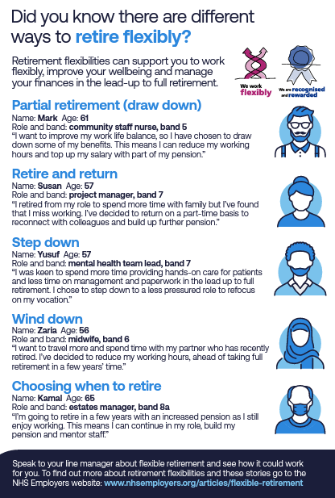
Flexible retirement web page
www.nhsemployers.org/articles/flexible-retirement
Notes:
[Imogen 10:50-10:55]
Our flexible retirement web page is a hub of information about flexible retirement, including what it is, how it can aid retention in your organisation and the benefits for employers.
It explains what each flexibility offers and provides a real life example of how the different flexibilities can be used in the service.
Also on this webpage, you can download a poster resource to use when speaking to your staff, which you can see on the right here. For each flexibility, it shows an employee explaining their situation and why they chose to retire flexibly. This will help you to discuss the benefits of each option with your staff.

Slide 9
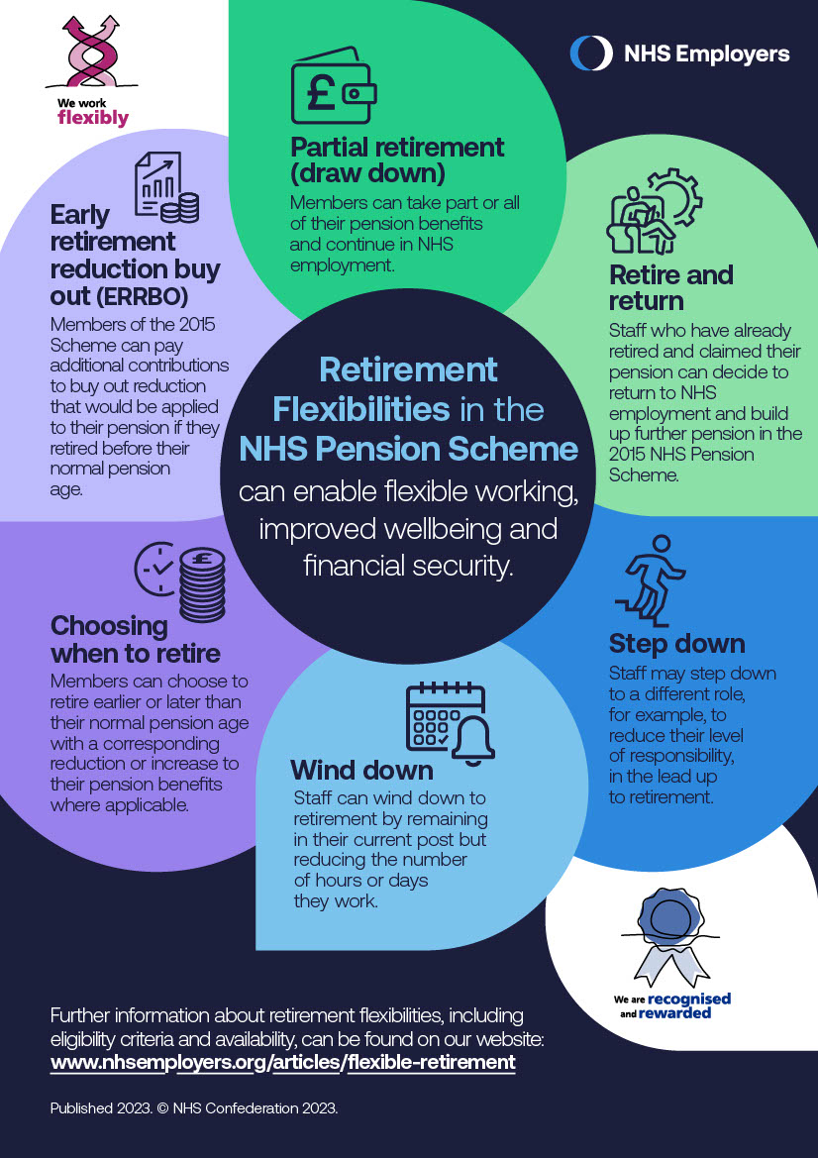
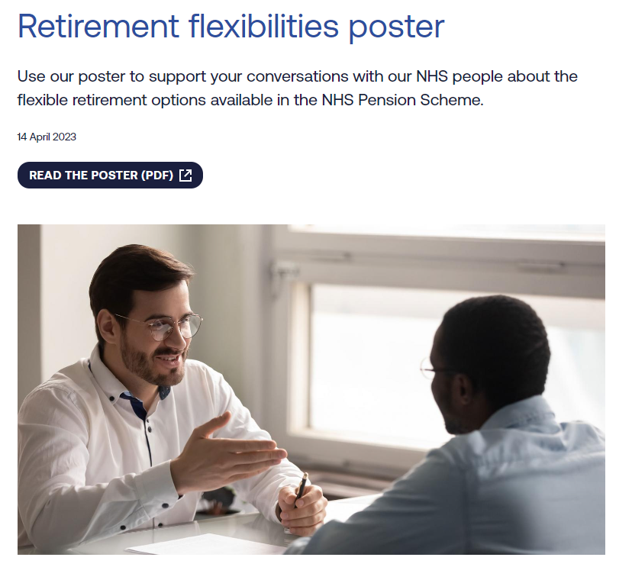
Flexible retirement poster
www.nhsemployers.org/publications/retirement-flexibilities-poster
Notes:
[Imogen 10:50-10:55]
We have another poster resource for you, our retirement flexibilities poster. It gives a visual and concise introduction to each flexible retirement option.
You can print and share the poster with staff or use it as a prompt during career or retirement planning conversations to help promote the options and raise awareness amongst employees.

Slide 10
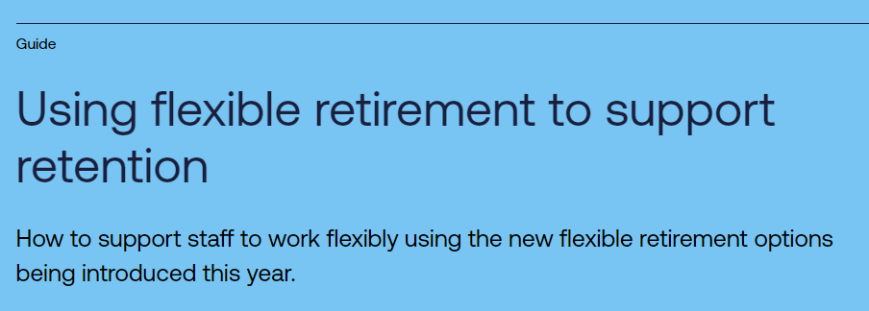
Guidance for employers on flexible retirement
www.nhsemployers.org/publications/using-flexible-retirement-support-retention
Notes:
[Imogen 10:50-10:55]
We talked earlier about our flexible retirement guidance for employers.
This guidance goes into some of the “how to” elements, for example, some of the ways you may want to consider to support staff to reduce their pensionable pay by 10 per cent.
We have recently updated this guidance since NHS Pensions has released more detailed information on partial retirement processes.

Slide 11
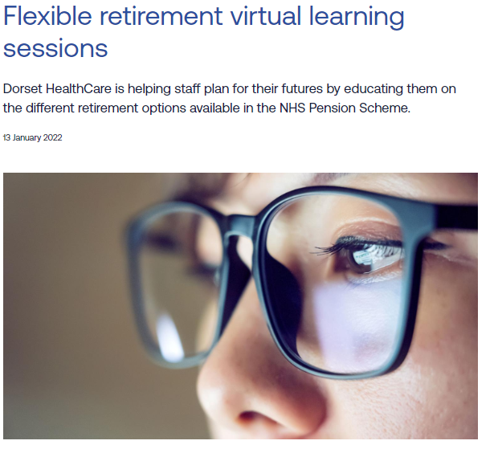
Flexible retirement options blog
https://www.nhsemployers.org/articles/flexible-retirement-virtual-learning-sessions
Notes:
[Imogen 10:50-10:55]
For an example of how to promote flexible retirement options to staff, this blog post shares some good practice from a trust who have run virtual learning sessions which have had a positive impact on their workforce.
In the blog, Dorset HealthCare discuss how they are retaining valuable staff by raising awareness of the different flexible retirement options available.
You can access all of these resources by searching “flexible retirement” on the NHS Employers website. The links for each specific resource are also at the bottom of the slides that you will be able to access after today on our website.

Slide 12
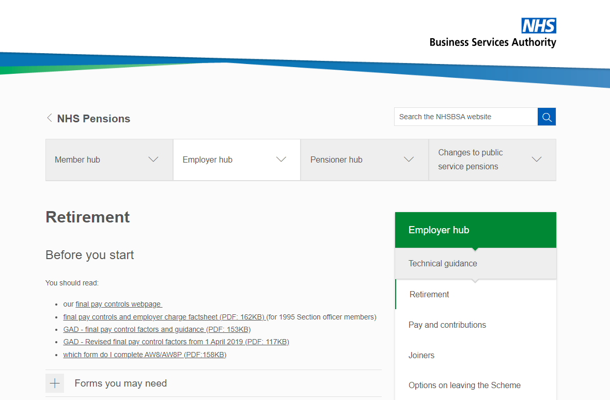
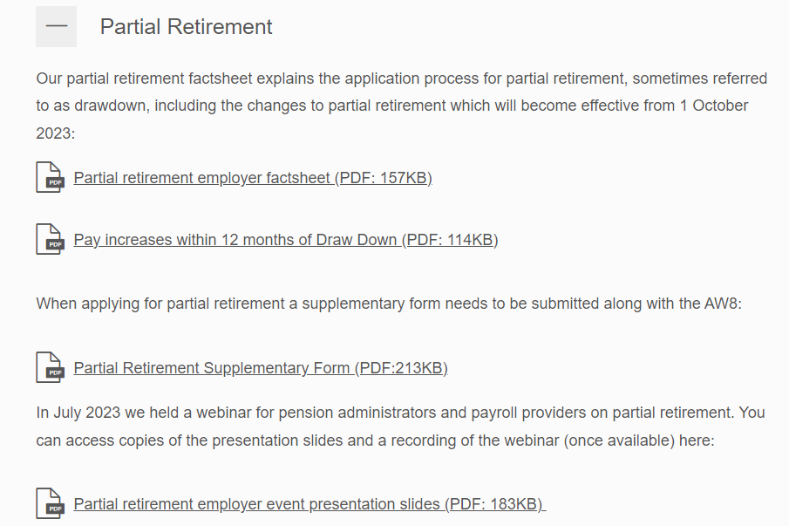
Resources from NHS Pensions
www.nhsbsa.nhs.uk/employer-hub/technical-guidance/retirement
Scroll down to the heading ‘Partial retirement’ for the employer factsheet,
Partial Retirement Supplementary Form, webinar recording and slides from 19 July
Notes:
[Imogen 10:50-10:55]
NHS Pensions, also known as NHS BSA, have more detailed guidance on their website to support employers with partial retirement processes. Here you can find their Employer factsheet, the Partial Retirement Supplementary form to be used during the application process, and the slides from the recent NHS Pensions partial retirement webinar held on 19th July.

Slide 13
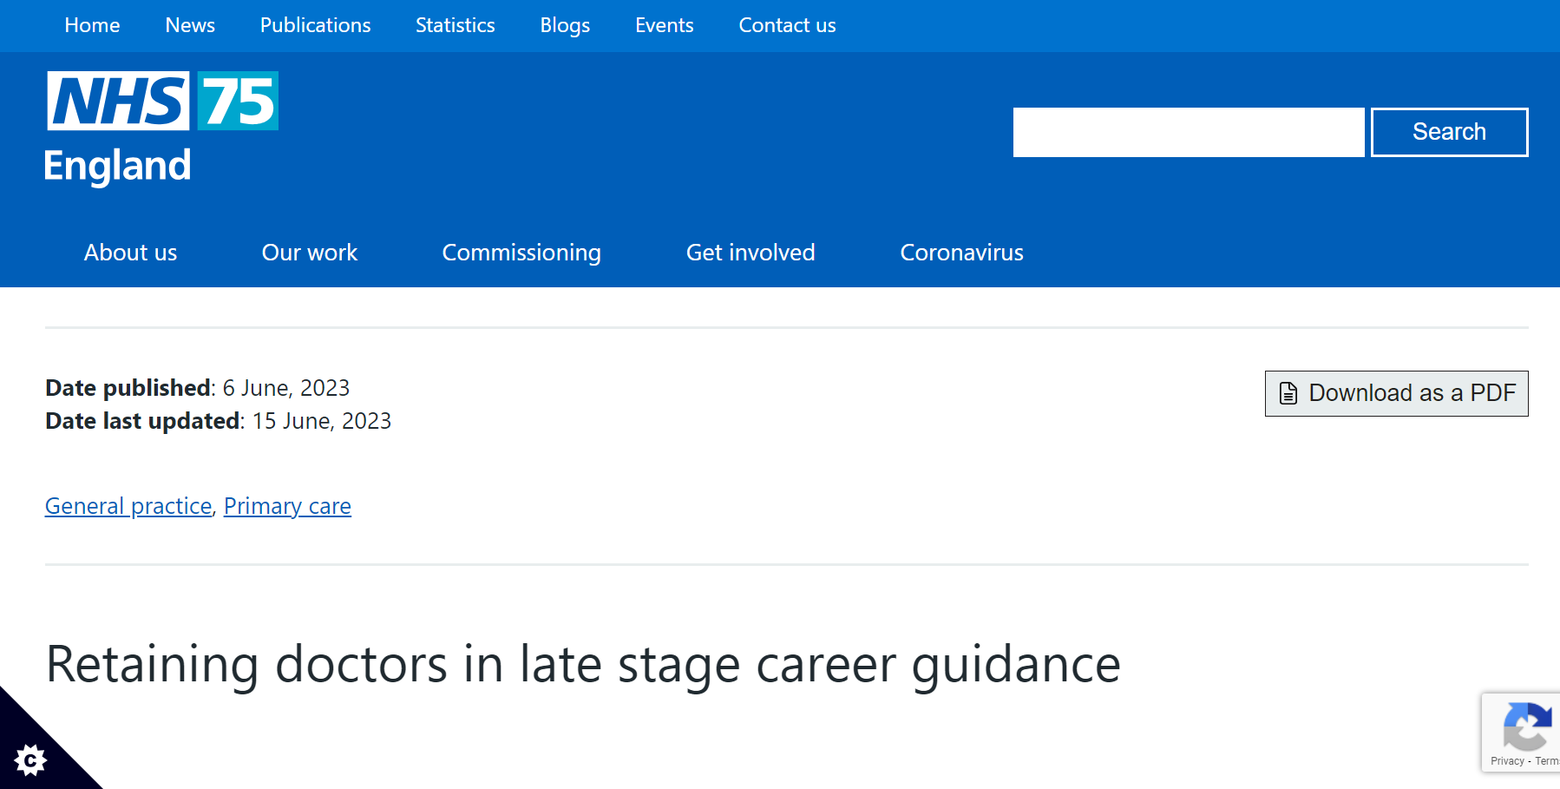
Resources from NHS England
www.england.nhs.uk/long-read/retaining-doctors-in-late-stage-career/
www.england.nhs.uk/looking-after-our-people/supporting-people-in-early-and-late-career/
www.england.nhs.uk/blog/the-soft-stuff-is-the-hard-stuff-one-year-into-the-people-promise-exemplars-programme/
Notes:
[Imogen 10:50-10:55]
NHS England have produced guidance which gives systems and employers strategies which may help them to retain experienced doctors in late-stage careers.
Many of the principles and recommendations are applicable to the wider NHS workforce.
You can also access NHS England’s retention hub, the links for both are on the slide.
You may have seen that Professor Em Wilkinson-Brice has released a blog updating on the People Promise Exemplars programme (launched in April 2022). The blog details some of the work the trusts have been part of and its impact – including that the leaver rate across the NHS as a whole is reducing month on month since August 2022.

Slide 14
Thank you.
2 Brewery Wharf
Kendall Street
Leeds LS10 1JR
0113 306 3000
www.nhsemployers.org
@NHSEmployers
Notes:
[Emma – 10:55-11am]
I’d like to thank everyone for their attendance today.
I hope you have found the webinar informative.
We will make the webinar recording and the slides available on our website in due course.

