Slide 1
NHS Pension Scheme
The value of membership
Introduction
July 2023

Slide 2


The value of the NHS Pension Scheme
Time to talk about pensions
www.nhsemployers.org/pensions

Slide 3
The full ten-point agenda
1
An overview
2
How much does the scheme cost?
3
How your pension builds up
4
Keeping track of your pension
5
Protection benefits
6
Leaving the scheme
7
Retiring from the scheme
8
Saving enough to stop work
9
Ways to increase your benefits
10
Pensions tax
Notes:
Purpose of Slide: To provide an overview of topics that will be covered during the session.
Notes for delivery: Edit slide if not presenting all topics. For example, if running a ‘new starter’ workshop then sections 1 to 5 are most relevant.
Points to note / warnings: Neither the presentation nor the speaker is offering independent financial advice.

Slide 4
NHS Pension Scheme
The value of membership
1. An Overview
July 2023

Slide 5
A benefit scheme for employers, members and their dependants
Cost is shared
You pay in
Income tax payers get
tax relief
Your employer pays in too
Payable on healthy retirement
…or in ill-health
Benefits for you
Pension payable for life
Tax-free cash
Life cover when in service
Protection for others
Benefits for adult dependants
…and children
Notes:
Purpose of slide: To provide employees with an overview of the features of saving into a workplace pension scheme.
Notes for delivery: Consider pointing out that some of the features highlighted here are common to many workplace schemes (tax relief / employer contribution). Explain how the cost of providing benefits is met by the employee, employer and HMRC through tax relief.
Explain the main benefits that the Scheme provides and that not only does the Scheme provide benefits directly for the member, it also provides benefits for dependants, should the worst happen. For new starters or “pension beginners” consider explaining what a pension is in very simple terms – e.g. “it’s a salary for your retirement, paid from the Scheme” from the point of retirement for the rest of your life.
Points to note / warnings: Where taxable income is under £12,570 pa (2023/24 Personal Allowance) there will be no tax relief.

Slide 6
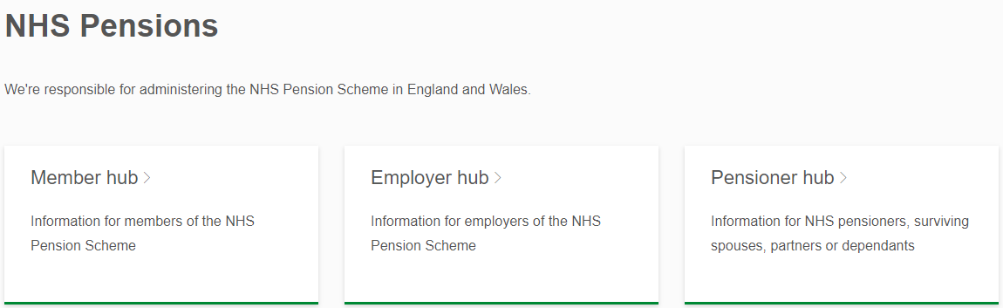


1. An overview
Further information
www.nhsbsa.nhs.uk/nhs-pensions
www.nhsemployers.org/pensions

Slide 7
NHS Pension Scheme
The value of membership
2. How much does the scheme cost?
July 2023

Slide 8
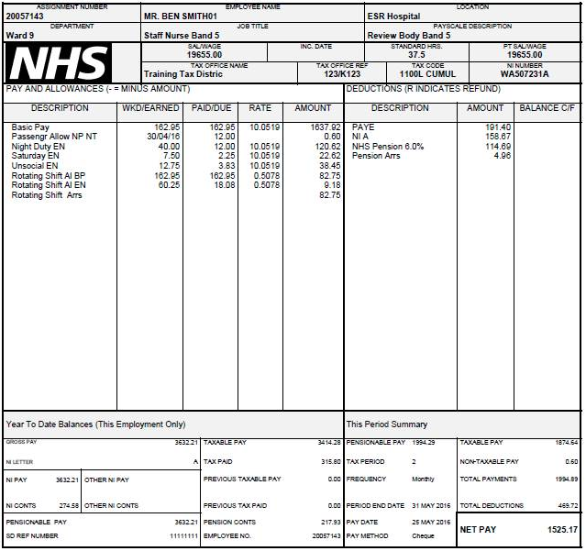

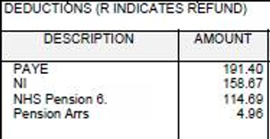
Your payslip
Notes:
Purpose of slide: To explain the payslip and its codes, so employees can familiarise themselves with the various terms and deductions applying.
Notes for delivery: Run through the key items, including the employee’s own pension contribution.
Point out the “SD reference number” which employees should have to hand when contacting the pension admin helpline.
Points to note / warnings: Payslips do not show the employer’s contribution. This will be covered later. Individuals will have different payments and deductions to those illustrated here. Individual payslips are likely to differ in format. This example payslip may become out of date over time.

Slide 9
Costs are shared between members and employers
From 1 April 2023
Tier | Actual Pensionable Pay | Member rate | Employer rate
1 | £0 to £13,246 | 5.1% | 20.6% + 0.08% admin levy
2 | £13,247 to £17,673 | 5.7%
3 | £17,674 to £24,022 | 6.1%
4 | £24,023 to £25,146 | 6.8%
5 | £25,147 to £29,635 | 7.7%
6 | £29,636 to £30,638 | 8.8%
7 | £30,639 to £45,996 | 9.8%
8 | £45,996 to £51,708 | 10.0%
9 | £51,709 to £58,972 | 11.6%
10 | £58,973 to £75,632 | 12.5%
11 | £75,633 and above | 13.5%
Notes:
Purpose of slide: To explain the rate that employees pay to the Scheme is dependent on actual pensionable pay
Not just employee who pays in, but the employer pays too. So, by not being in the Scheme, employees are missing out on employer contributions towards their retirement. Employers also pick up the cost of the administration of the Scheme.
Notes for delivery: Explain the concept of actual pensionable pay
Points to note / warnings: Rates correct at the time of writing (2023). Rates for both employees and employers may change in the future.

Slide 10
The tax office helps you save too
(2023/24)
Income tax bands – for all England & Wales (not just NHS staff)
e.g. £40,000 gross pay
No tax
20% tax
Notes:
Purpose of slide: To help employees to understand, broadly, how income tax applies to their pay.
Notes for delivery: Important to note that tax bands are not specific to NHS but all England & Wales. Speaker can use examples to explain that pension contributions reduce the employee’s taxable earnings, so that they pay less income tax.
Points to note / warnings: Tax bands are correct at time of writing (2023/24). These will become out of date over time and should be reviewed and revised accordingly.
If presenting to higher earners, could provide further information about the loss of the tax-free “personal allowance” as earnings exceed £100,000.

Slide 11
The tax office helps you save too
(2023/24)
Income tax bands – for all England & Wales (not just NHS staff)
e.g. £80,000 gross pay
No tax
20% tax
40% tax
Notes:
Purpose of slide: To help employees to understand, broadly, how income tax applies to their pay.
Notes for delivery: Important to note that tax bands are not specific to NHS but all England & Wales. Speaker can use examples to explain that pension contributions reduce the employee’s taxable earnings, so that they pay less income tax.
Points to note / warnings: Tax bands are correct at time of writing (2023/24). These will become out of date over time and should be reviewed and revised accordingly.
If presenting to higher earners, could provide further information about the loss of the tax-free “personal allowance” as earnings exceed £100,000.

Slide 12
The tax office helps you save too
(2023/24)
Income tax bands – for all England & Wales (not just NHS staff)
How tax relief works (for every £1 you pay into the scheme)
Yearly income under £12,570pa
Yearly income £12,570pa to £50,270pa
Yearly income
£50,270pa to £125,140pa
Yearly income over
£125,140pa
Tax relief £0
You pay £1
Tax relief 20p
You pay 80p
Tax relief 40p
You pay 60p
Tax relief 45p
You pay 55p
By paying into the scheme, you pay less tax
Notes:
Purpose of slide: To build on the previous slide and provide detail on the tax relief applicable for various bands of earnings.
Notes for delivery: Tax relief is expressed in terms of every £1 paid into the Scheme in employee contributions (not allowing for breaches in the Annual and/or Lifetime Allowances – see section 10).
Points to note / warnings: Tax bands are correct at time of writing. These will become out of date over time and should be reviewed and revised accordingly.

Slide 13




Example pay slip
Annual pay of £20,000 (2023/24)
Monthly pay slip | Not in scheme | In the scheme
Gross pay | £1,667 | £1,667
Pension (6.1%) | - | (£102)
Income tax | (£124) | (£104)
National Insurance | (£74) | (£74)
Take-home pay | £1,469 | £1,387
Your total pension
contribution is £102
But you’ve paid
£20 less tax
And your employer
paid in £345
Over the year,
you will give up…
If you receive this for around 3 years, you’ve made your money back!
Over the year,
your employer will pay…
Giving you a gross pension in the 2015 Scheme of..
£984 in
take-home pay
£4,136 towards
your retirement
£370 paid
every year for life
Notes:
Purpose of slide: To explain how employee contributions attract tax relief, the employer contribution and what it will provide in retirement. There are 3 slides based on different levels of pay.
Notes for delivery: Compare the deductions applying to a person who is not in the Scheme, to a person who is. Pension saving can be considered to be a tax efficient way to save towards retirement. Explain the employer contribution is only paid if the employee is a member of the Scheme. Illustrate, in very simple terms, what the payback period is (although the pension is paid for life).
Points to note / warnings: Speaker can delete unwanted examples, or design new ones, depending on the audience. Tax bands are correct at time of writing (2023/24). These will become out of date over time and should be reviewed and revised accordingly.

Slide 14
Example pay slip
Annual pay of £25,000 (2023/24)
Monthly pay slip | Not in scheme | In the scheme
Gross pay | £2,083 | £2,083
Pension (6.8%) | - | (£142)
Income tax | (£207) | (£179)
National Insurance | (£124) | (£124)
Take-home pay | £1,752 | £1,638
Your total pension
contribution is £142
But you’ve paid
£28 less tax
And your employer
paid in £431
Over the year,
you will give up…
If you receive this for around 4 years, you’ve made your money back!
Over the year,
your employer will pay…
Giving you a gross pension in the 2015 Scheme of..
£1,368 in
take-home pay
£5,170 towards
your retirement
£463 paid
every year for life
Notes:
Purpose of slide: To explain how employee contributions attract tax relief, the employer contribution and what it will provide in retirement. There are 3 slides based on different levels of pay.
Notes for delivery: Compare the deductions applying to a person who is not in the Scheme, to a person who is. Pension saving can be considered to be a tax efficient way to save towards retirement. Explain the employer contribution is only paid if the employee is a member of the Scheme. Illustrate, in very simple terms, what the payback period is (although the pension is paid for life).
Points to note / warnings: Speaker can delete unwanted examples, or design new ones, depending on the audience. Tax bands are correct at time of writing (2023/24). These will become out of date over time and should be reviewed and revised accordingly.

Slide 15
Example pay slip
Annual pay of £40,000 (2023/24)
Monthly pay slip | Not in scheme | In the scheme
Gross pay | £3,333 | £3,333
Pension (9.8%) | - | (£327)
Income tax | (£457) | (£392)
National Insurance | (£274) | (£274)
Take-home pay | £2,602 | £2,340
Your total pension
contribution is £327
But you’ve paid
£65 less tax
And your employer
paid in £689
Over the year,
you will give up…
If you receive this for around 4 years, you’ve made your money back!
Over the year,
your employer will pay…
Giving you a gross pension in the 2015 Scheme of..
£3,144 in
take-home pay
£8,272 towards
your retirement
£741 paid
every year for life
Notes:
Purpose of slide: To explain how employee contributions attract tax relief, the employer contribution and what it will provide in retirement. There are 3 slides based on different levels of pay.
Notes for delivery: Compare the deductions applying to a person who is not in the Scheme, to a person who is. Pension saving can be considered to be a tax efficient way to save towards retirement. Explain the employer contribution is only paid if the employee is a member of the Scheme. Illustrate, in very simple terms, what the payback period is (although the pension is paid for life).
Points to note / warnings: Speaker can delete unwanted examples, or design new ones, depending on the audience. Tax bands are correct at time of writing (2023/24). These will become out of date over time and should be reviewed and revised accordingly.

Slide 16


2. How much does the scheme cost?
Further information
www.nhsemployers.org/publications/nhs-pension-scheme-member-contributions-202324
www.nhsemployers.org/articles/nhs-pension-scheme-employer-contributions

Slide 17
NHS Pension Scheme
The value of membership
3. How your pension builds up
July 2023

Slide 18


Guaranteed income in retirement based on your pay
‘Old’
scheme
‘New’
scheme
NHS Pension Scheme
Final
Salary
Career
Average
Notes:
Purpose of slide: To introduce the NHS Pension Schemes and another opportunity to explain what a pension is in simple terms.
Notes for delivery: Explain the changes in the NHS pension offering through the various schemes over time.
Some employees might have benefits in both Schemes, mention this if appropriate. Tailor to audience – e.g. if new starter session, point out 2015 Scheme is used for auto-enrolment and that they cannot join the ‘old’ Scheme. Colour coding for schemes used from this point on, for consistency.
Points to note / warnings: Total Reward Statements will show which Scheme employees are in.

Slide 19
Career Average pensions (2015)
Your pension builds up in slices, using your pay in every year
Uses pay
in year 1
Uses pay
in year 2
Uses pay
in year 3
Uses ‘average’ pay across whole career
At retirement your pension is paid every year, for life
Pension paid
in year 1
Pension paid
in year 2
Pension paid
in year 3
Pension paid
in year 4
Pension paid
in year 5
Pension paid
in year 6
Pension paid
in year 7 & on…
Notes:
Purpose of slide: To broadly explain how pension builds up in the 2015 Scheme.
Notes for delivery: Each year, a scheme member will build up another “slice” of Career Average pension. The slice is based on Pensionable Pay in the year the pension was built up. Colours are intended to indicate that the slices making up pension are based on slices of pay from each and every year. This is why it is called a ‘Career Average’ scheme – because, broadly, it’s based on an average of pay whilst a member of the Scheme (not on Final Salary at retirement). Total pension at retirement is based on the sum of all these slices (with inflation protection included, known as revaluation). The pension is paid each and every year for life from retirement.
Points to note / warnings: Slices are all the same size – however in reality different pay in different years will lead to different “slices” of pension adding up. Full circle is not intended to indicate number of years required for pension.

Slide 20
Final Salary pensions (1995/2008)
Your pension builds up in slices, using your pay near the end of each year
Uses Final Salary at end of year 1
Uses Final Salary at end of year 2
Uses Final Salary at end of year 3
Uses Final Salary at retirement (or earlier leaving)
At retirement your pension is paid every year, for life
Pension paid
in year 1
Pension paid
in year 2
Pension paid
in year 3
Pension paid
in year 4
Pension paid
in year 5
Pension paid
in year 6
Pension paid
in year 7 & on…
Notes:
Purpose of slide: To broadly explain how Final Salary pension schemes (such as the 1995/2008 Scheme) work.
Notes for delivery: Each year, a scheme member will build up another “slice” of Final Salary pension. Colour is intended to indicate that all pension built up (i.e. each slice) is based on member’s Final Salary.
As for Career Average, the pension is paid every year for life, from retirement.
Points to note / warnings: Full circle is not intended to indicate number of years required for pension.

Slide 21
How much pension builds up?
1995 Section (example using pay of £20,000pa)
Benefit structure
1995 Section
Benefits built up in 1 year
Benefits built up in 20 years
Pay used
Best of last
3 years’ pay
Pension
as proportion of pay
1/80th or 1.25%
1.25% of pay = £250 per year
1.25% x 20 x pay = £5,000 per year
One off lump sum at retirement
3 x pension
£750 lump sum
£15,000 lump sum
But can give up some pension for (more) cash
Normal
Pension Age
60
Pension amount does not depend on any investment performance
Notes:
Purpose of slide: To provide more detail on how pension builds up in the 1995 Section of the ‘old’ NHS Pension Scheme.
Notes for delivery: This slide uses a simplified example based on annual Pensionable Pay of £20,000. Speaker should talk through the each of the headline features:
the pay used;
the size of the “slice” that build up each year (fraction / % terms);
the automatic lump sum that is included in the pension; and
Normal Pension Age – and what this means.
Points to note / warnings: Very simplified example for the figures used in the 1-year build up and 20-year build up. Ignores details such as salary increases. Intended to help drill down to pension fundamentals rather than provide an accurate pension statement.

Slide 22
How much pension builds up?
2008 Section (example using pay of £20,000pa)
Benefit structure
2008 Section
Benefits built up in 1 year
Benefits built up in 20 years
Pay used
Best 3 year average from last 10
Pension
as proportion of pay
1/60th or 1.67%
1.67% of pay = £333 per year
1.67% x 20 x pay = £6,670 per year
One off lump sum at retirement
Nil
Nil
Nil
But can give up some pension for cash
Normal
Pension Age
65
Pension amount does not depend on any investment performance
Notes:
Purpose of slide: To provide more detail on how pension builds up in the 2008 Section of the ‘old’ NHS Pension Scheme.
Notes for delivery: This slide uses a simplified example based on annual Pensionable Pay of £20,000. Speaker should talk through the each of the headline features:
the pay used;
the size of the “slice” that build up each year (fraction / % terms);
Normal Pension Age – and what this means.

Slide 23
How much pension builds up?
2015 Scheme (example using pay of £20,000pa)
Benefit structure
2015 Scheme
Benefits built up in 1 year
Benefits built up in 20 years
Pay used
Pensionable pay over career
Pension
as proportion of pay
1/54th or 1.85%
1.85% of pay = £370 per year
1.85% x 20 x pay = £7,400 per year
One off lump sum at retirement
Nil
Nil
Nil
But can give up some pension for cash
Normal
Pension Age
State Pension Age (65+)
Pension amount does not depend on any investment performance
Notes:
Purpose of slide: To provide more detail on how pension builds up in the ‘new’ 2015 Scheme.
Notes for delivery: This slide uses a simplified example based on annual Pensionable Pay of £20,000. Speaker should talk through the each of the headline features:
the pay used;
the size of the “slice” that build up each year (fraction / % terms);
Normal Pension Age – and what this means.
Points to note / warnings: Very simplified example for the figures used in the 1-year build up and 20-year build up. Ignores details such as salary increases. Intended to help drill down to pension fundamentals rather than provide an accurate pension statement.

Slide 24
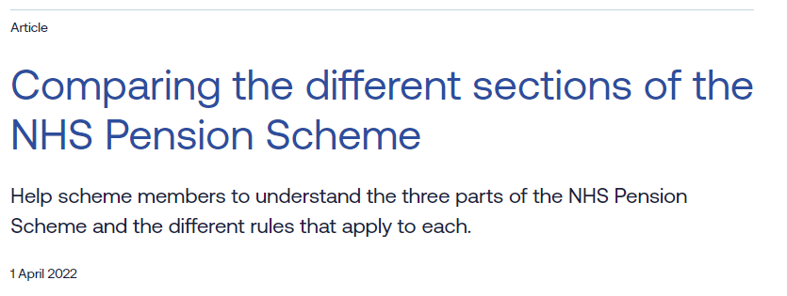
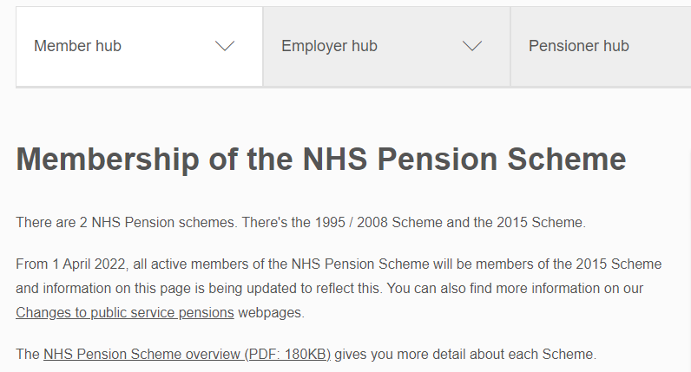
3. How your pension builds up
Further information
https://www.nhsemployers.org/articles/comparing-different-sections-nhs-pension-scheme
www.nhsbsa.nhs.uk/member-hub/membership-nhs-pension-scheme

Slide 25
NHS Pension Scheme
The value of membership
4. Keeping track of your pension
July 2023

Slide 26
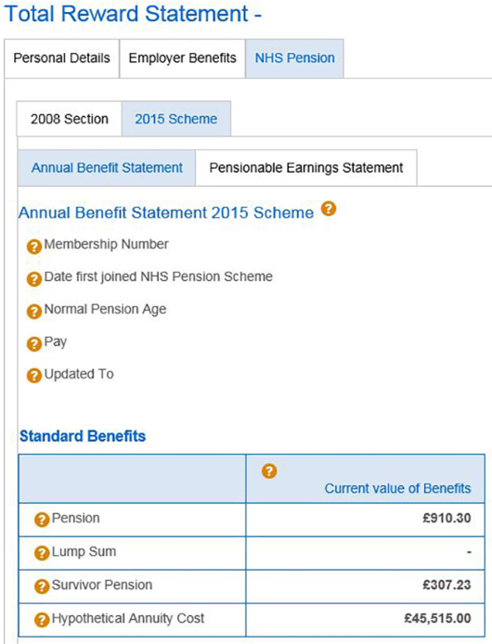
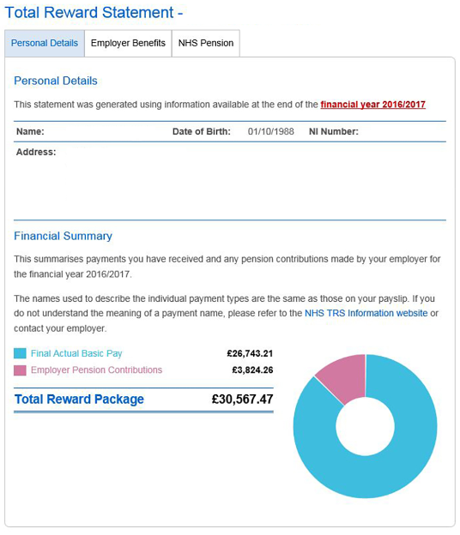
How do you know what you’ve got? www.totalrewardstatements.nhs.uk
financial year 2022/23
Your pension payable from Normal Pension Age
2022/23.
Total reward, including employer pension contributions
A guide to how much your pension would cost to buy from an insurance company
Notes:
Purpose of slide: To explain the features of the Total Reward Statement, how and where employees can log in and the information displayed on the TRS.
Notes for delivery: Explain what each bit of key information is showing the employees, and that this can be used to help them keep track of their pension benefits.
Points to note / warnings: Consider enabling attendees to access TRS during the session.

Slide 27
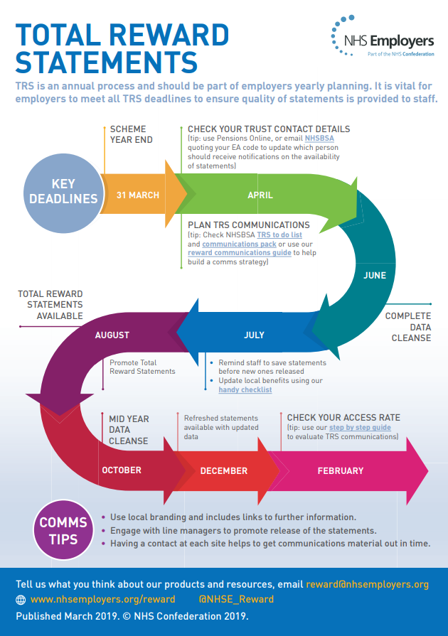
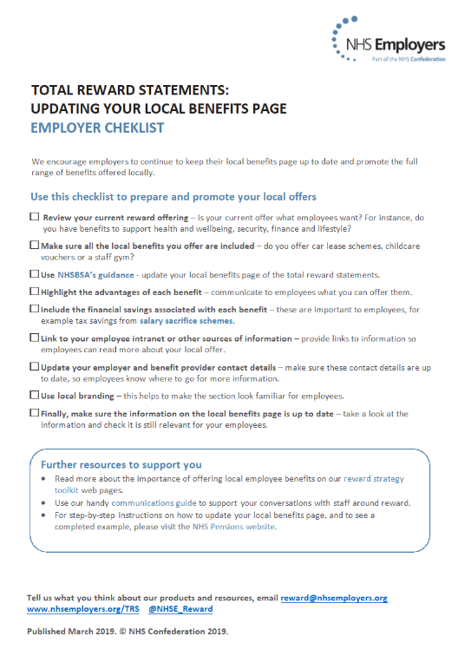
4. Keeping track of your pension
Further information
www.nhsemployers.org/articles/total-reward-statements?

Slide 28
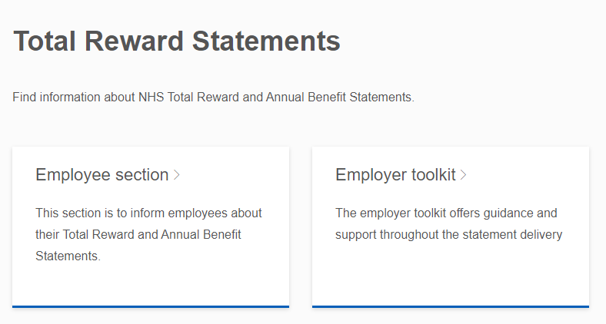
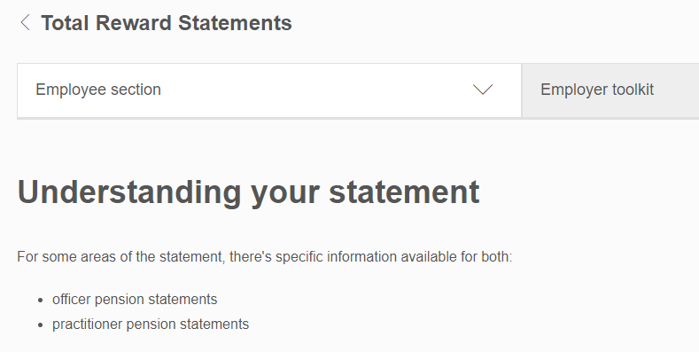
4. Keeping track of your pension
Further information
www.nhsbsa.nhs.uk/total-reward-statements
https://www.nhsbsa.nhs.uk/employee-section/understanding-my-statement

Slide 29
NHS Pension Scheme
The value of membership
5. Protection benefits
July 2023

Slide 30
Benefits for dependants
Family benefits in the NHS Pension Scheme
Leave
Retire
In active service
In deferment
In retirement
Pension
Payable to spouse/partner for the rest of their life
And dependent children (generally until age 23)
Increased pension if member dies in active service
Life assurance lump sum
Most significant lump sum is paid when death is in active service
Broadly this is 2 times yearly pensionable pay
Notes:
Purpose of slide: To provide discussion points for death benefits which fall into two categories – pension for spouse / partner / eligible children, and lump sum payments.
Notes for delivery: Speaker to point out different benefits are payable depending on when death occurs – in active service, in deferment or after retirement.
Highlight that members can nominate who any lump sum should be paid to using a nomination form “DB2” available from the members’ hub. Members should keep these up to date.
Points to note / warnings: May need to clarify technical terms – who qualifies as an eligible dependant for example.

Slide 31
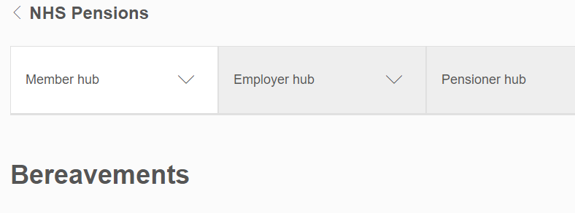
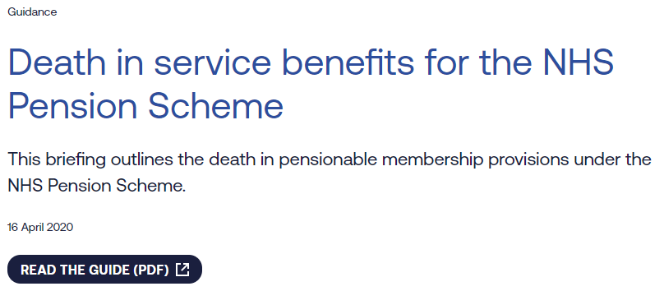
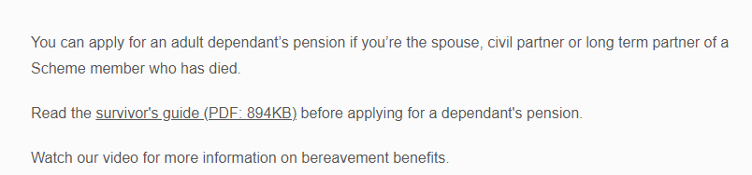
5. Protection benefits
Further information
https://www.nhsemployers.org/publications/death-service-benefits-nhs-pension-scheme
www.nhsbsa.nhs.uk/member-hub/bereavements

Slide 32
NHS Pension Scheme
The value of membership
6. Leaving the scheme
July 2023
Notes:
Purpose of slide: To explain the different benefits payable depending on whether an employee leaves before or after 2 years if service.
Notes for delivery: If appropriate, speaker can provide more information on what service is included – e.g. for returning employees.
Purpose to explain that benefits are not lost if employees leave the scheme / employment.
Points to note / warnings: Re-joining the scheme can mean that employees can link up previous periods of service.

Slide 33
Leaving the scheme
Join the scheme
2 years’ service
Retirement age
Leave with
less than
2 years’ service
Leave with
more than
2 years’ service
Receive a refund of YOUR contributions
(less tax)
Your pension stays in the scheme
Payable from retirement age
Inflation protection

Slide 34
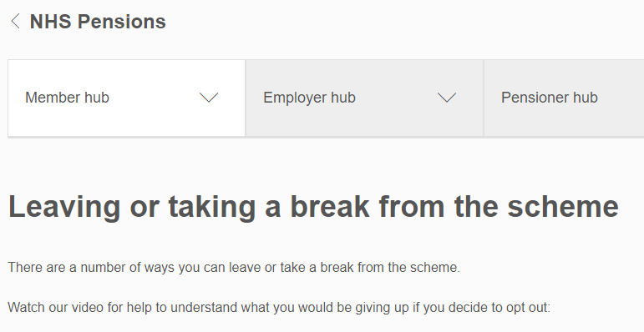
6. Leaving the scheme
Further information
www.nhsbsa.nhs.uk/member-hub/leaving-or-taking-break-scheme

Slide 35
NHS Pension Scheme
The value of membership
7. Retiring from the scheme
July 2023

Slide 36
Drawing your pension
1995 Section
2008 Section
2015 Scheme
Normal
Pension
Age
State Pension Age
Between 65 & 68
60
65
Retiring early (not VR)
Your pension starts at a lower amount as paid earlier and for longer
From 55
(or 50 if joined before 06/04/2006)
From 55
From 55
Retiring late
(max age 75)
Maximum 45 years’ service
No increase for retiring late
Maximum 45 years’ service
Pension increased for retiring late
No maximum service
Pension increased for retiring late
Notes:
Purpose of slide: To explain the different Normal Pension Ages (NPA) and what this means in terms of being able to retire earlier or later than NPA.
Notes for delivery: Explain that this slide covers information at a very high level, and some employees may have benefits across different schemes/sections.
Points to note / warnings: Be clear that early retirement pensions do not step back up to “full” amount at NPA. Information is provided at a high level and does not cover, for example, Special Class status and Mental Health Officers.

Slide 37

Choosing benefits at retirement
Example – 2015 Scheme
Take a full pension
…OR give up some pension
for tax-free cash
(£12 cash for £1 pa pension)
Maximum tax-free
cash of £42,800…
You don’t have to take the maximum tax-free cash
Notes:
Purpose of slide: To explain the option of giving up pension for tax- free cash at retirement using the 2015 Scheme as an example.
Notes for delivery: If appropriate to the audience, can provide details on how this works for in the 1995/2008 Scheme.
Points to note / warnings: Tax-free cash is an option for all pension schemes - not just an option for the NHS Pension Scheme.

Slide 38
Flexible retirement
Step down
Wind down
Draw down
Retire & return
Continue working in the NHS
Remain in
current post
Continue working in the NHS
Leave employment and claim pension
Step down to a different role
Work fewer hours
Partially draw down benefits
Take a short break
Protected pay for 1995/2008 pensions
No impact on past pensions
Can build up more pension
Members can build up more pension
1995 Section
✓
✓
✓*
✓
2008 Section
✓
✓
✓
✓
2015 Scheme
✓
✓
✓
✓
*From 1 October 2023
Notes:
Purpose of slide: To explain the different ways that employees can approach retirement across the schemes/sections.
Notes for delivery: Speaker can discuss that “retirement” is not necessarily a single point in time, employees have a number of flexibilities around how to approach it. The terms used are those used in NHS literature.
Points to note / warnings: Correct at time of writing – speakers should ensure flexibilities are correct at time of presenting. Important to stress that “retire & return” is an employer flexibility rather than a right for employees.

Slide 39
Ill-health retirement
(with at least 2 years’ service)
Permanently ill and unable to do current job
“Tier 1” benefits
Pension paid without reduction for early payment
Permanently ill and unable to do any job
Pension (calculated with extra service) paid without reduction for early payment
“Tier 2” benefits
Terminally ill
Benefits paid in a single lump sum
Notes:
Purpose of slide: To explain the ability for employees in ill health to draw a pension from the Scheme. Also, to explain the different categories of ill health retirement and benefits payable if criteria is met.
Notes for delivery: Can consider explaining terms/definitions – e.g. terminally ill for these purposes means less than 12 months to live.
Points to note / warnings: Correct at time of writing – speakers should ensure options and availability across the schemes are correct at time of presenting.

Slide 40
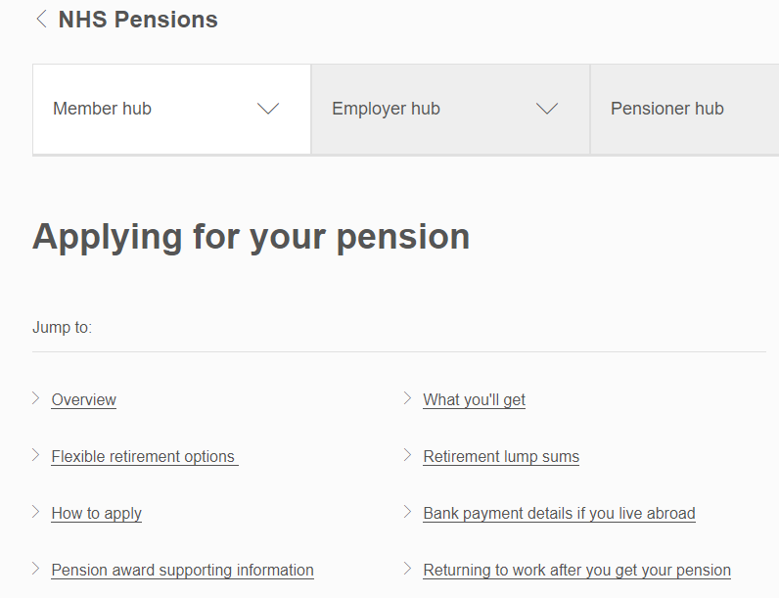
7. Retiring from the scheme
Further information
www.nhsbsa.nhs.uk/member-hub/applying-your-pension

Slide 41
NHS Pension Scheme
The value of membership
8. Saving Enough To Stop Work
July 2023

Slide 42
Your total retirement income might be made up of…
Other
pensions
NHS pension
State pension
Other
savings
Notes:
Purpose of slide: To discuss different sources of financial support for life after retirement and encourage employees to start thinking about their own.
Notes for delivery: Saving for retirement can take many forms, with benefits in the NHS Pension Scheme one part of it.
Points to note / warnings: May not apply to all – for example perhaps UK State pension may not be payable if insufficient National Insurance contributions paid.

Slide 43
How much is enough money to stop work?
% income replacement
= pension ÷ pay
Lots of research
50% to 75%
of pay?
To pay for the basics…
…the lower your pay, the higher the % needed
But what is right for you?
Think it through with your partner
…the higher your pay, the lower the % needed
Notes:
Purpose of slide: To give some very high level ideas of how much is needed in retirement.
Notes for delivery: There is research to suggests somewhere between 50% to 75% of annual pay (as an annual income) after retirement. Explain income replacement ratio, and how this tends to increase for the lower paid to sustain a basic standard of living.
Encourage employees to think this through themselves as a household so that total financial picture considered.

Slide 44
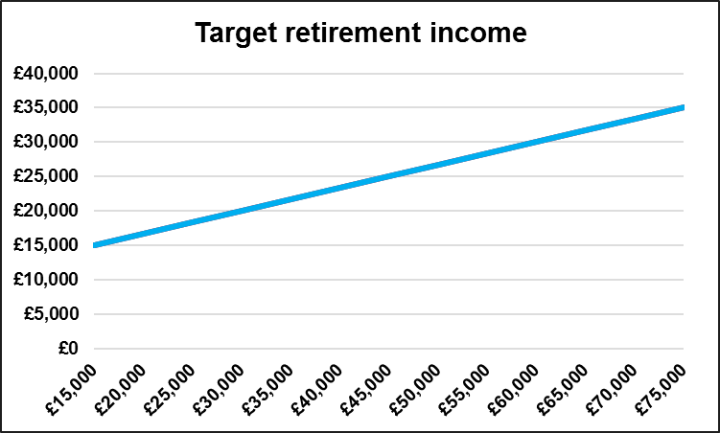
How much is enough?
‘Rough rule of thumb’
Target income
= £15,000 + (Pay over £15,000) ÷ 3
Pay £25,000 pa
Target £18,300 pa
Pay £50,000 pa
Total retirement income (per year)
Target £26,700 pa
Pay £75,000 pa
Target £35,000 pa
Notes:
Purpose of slide: To illustrate a very broad “rule of thumb” to help employees consider a high level target income.
Notes for delivery: Rule of thumb is for the target income to be £15,000 plus one-third of pay at retirement above this level. Speaker should explain by talking through examples.
Other approaches possible to target setting – alternatives will be considered next.
Points to note / warnings: Not intended as advice. It is intended as a high level starting point to help employees start to think about retirement planning.
Employees should consider their own circumstances and financial position in detail.

Slide 45

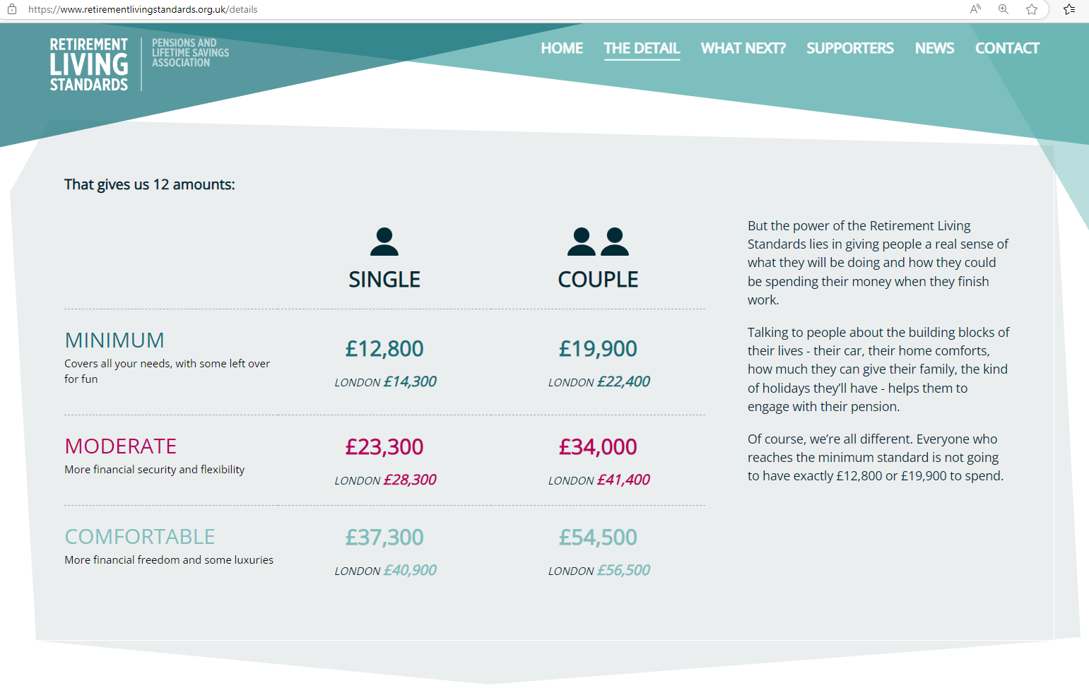
Retirement Living Standards website
https://www.retirementlivingstandards.org.uk/

Slide 46
But if you want to keep income the same
Income – Pay of £25,000
Over a year | Pay in work | Total retirement income target
Gross amount | £25,000 | £21,210
Pension (7.7%) | (£1,925) | Nil
Income tax | (£2,101) | (£1,728)
National Insurance | (£1,492) | Nil
What you actually receive | £19,482 | £19,482
85%
100%
Remember – your total retirement income could be made up from the
State Pension, NHS Pension and other saving sources.
Notes:
Purpose of slide: To consider a second approach to target income setting – to maintain same level of net income. Uses pay of £25,000.
Notes for delivery: Slide explains that even if employee wants to maintain same level of net income after retirement as they received whilst in work, they may need less gross income because of the different deductions applying in work and in retirement.
Points to note / warnings: Rates, taxes and contribution percentages correct at time of writing (2023/24) – speaker should check these remain correct. Slide considers all sources of post retirement income – not just from the NHS Pension Scheme.
Not intended as advice. It is intended as a high level starting point to help employees start to think about retirement planning. Employees should consider their own circumstances and financial position in detail.

Slide 47
But if you want to keep income the same
Income – Pay of £40,000
Over a year | Pay in work | Total retirement income target
Gross amount | £40,000 | £31,965
Pension (9.8%) | (£3,920) | Nil
Income tax | (£4,702) | (£3,879)
National Insurance | (£3,292) | Nil
What you actually receive | £28,086 | £28,086
80%
100%
Remember – your total retirement income could be made up from the
State Pension, NHS Pension and other saving sources.
Notes:
Purpose of slide: To consider a second approach to target income setting – to maintain same level of net income. Uses pay of £40,000
Notes for delivery: Slide explains that even if employee wants to maintain same level of net income after retirement as they received whilst in work, they may need less gross income because of the different deductions applying in work and in retirement.
Points to note / warnings: Rates, taxes and contribution percentages correct at time of writing (2023/24) – speaker should check these remain correct. Slide considers all sources of post retirement income – not just from the NHS Pension Scheme.
Not intended as advice. It is intended as a high level starting point to help employees start to think about retirement planning. Employees should consider their own circumstances and financial position in detail.

Slide 48
How much is enough?
A detailed approach
Spending might go down
Spending might go up
No mortgage
More holidays
Children finally
left home
More leisure time
Don’t have to save
for retirement
Heating bills
No National
Insurance to pay
Long term care
Notes:
Purpose of slide: To discuss how income needs change after retirement as a result of different spending patterns.
Notes for delivery: This is a more detailed approach to target setting which employees should consider for their retirement planning.
Points to note / warnings: Not intended as advice. It is intended as a high level starting point to help employees start to think about retirement planning.
Employees should consider their own circumstances and financial position in detail.

Slide 49
State Pension
When you might get it?
Your date of birth | State Pension Age
Before 6 April 1954 | Already reached State Pension Age
Between 6 April 1954 and 5 April 1960 | 66th birthday
Between 6 April 1960 and 5 March 1961 | Between 66th and 67th birthdays
Between 6 March 1961 and 5 April 1977 | 67th birthday
Between 6 April 1977 and 5 April 1978 | Between 67th and 68th birthdays
6 April 1978 onwards | 68th birthday
https://www.gov.uk/state-pension-age
Notes:
Purpose of slide: To introduce the State Pension and the age at which it will become payable (“State Pension Age”). Also, to show how State Pension Age has changed over time.
Notes for delivery: State Pension Age is also the Normal Pension Age for the 2015 NHS Pension Scheme.
Points to note / warnings: State Pension Age graph correct at time of writing – speakers should ensure it remains correct at time of presenting.

Slide 50
Will the State Pension be worth waiting for?
Weekly Amount
(2023 prices)
Average years in payment
Average amount paid over lifetime
Date
Age
1909
70
£20
9 years
£8,000
8 years
W: 60
M: 65
19.5 years
£36,000
1948
£45
13 years
2023
66
£203
23 years
£250,000
21 years
2040
68+
£203+
24 years
£250,000+
But will be lower if you’ve been in the NHS Pension Scheme for several years
22 years
60
70
80
90
Notes:
Purpose of slide: To discuss how the State Pension has changed over time, and how it can be a valuable part of retirement income.
Notes for delivery: Explain the age at which the State Pension is payable from, the weekly amount paid (approximate amounts in today’s money terms), the average time for which it was paid based on life expectancy at the time, and the average total amount paid out. Slide provides prompt to explain that prior to April 2016 NHS Pension Scheme members were “contracted-out” of the State Second Pension so may not receive the maximum State Pension.
Points to note / warnings: Average amount paid out over lifetime provided in very broad, simple terms (no inflation / interest etc assumed – simply weekly amount multiplied by average life expectancy, rounded down to nearest £1,000).
Information correct at time of writing – speakers should ensure it remains correct at time of presenting.

Slide 51

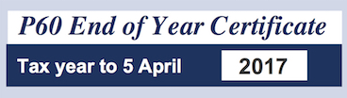
Request a State Pension Statement
Go to: www.gov.uk/check-state-pension
You will need one of these:
2023
Notes:
Purpose of slide: To explain how to obtain a State Pension Statement on-line, and what information is needed to access this (payslip / passport / P60).
Notes for delivery: The process is fairly simple and employees should be encouraged to carry this out.
Points to note / warnings: As mentioned on the previous slide, employees who have been contracted-out may not be on track to receive the full State Pension. This will help individuals manage their own State Pension expectations.

Slide 52
What your State Pension forecast might look like
You can get your State Pension on 6 May 2044. Your forecast is
£203.85 a week
£883.35 a month, £10,600.20 a year
You need to continue to contribute National Insurance to reach your forecast
Estimate based on your National Insurance record up to 5 April 2023
Forecast if you contribute another 5 years before 5 April 2044
£203.85 a week
Your forecast
is not a guarantee and is based on the current law
does not include any increase due to inflation
£170.78 a week
Notes:
Purpose of slide: To illustrate what an online State Pension Statement will look like.
Notes for delivery: Explain what the example figures mean – what has been built up to date, and what might be paid on retirement subject to sufficient National Insurance contributions.
Points to note / warnings: Amounts are an illustration only at time of writing – speaker should consider updating at time of presenting.

Slide 53
Are you on track?
Piece together your savings
Other
pensions
NHS pension
Ask for retirement quotes
Consider your total income needs for retirement
State pension
At what age would you like
to stop work?
Other
savings
Look closely at your budget and spending

Slide 54
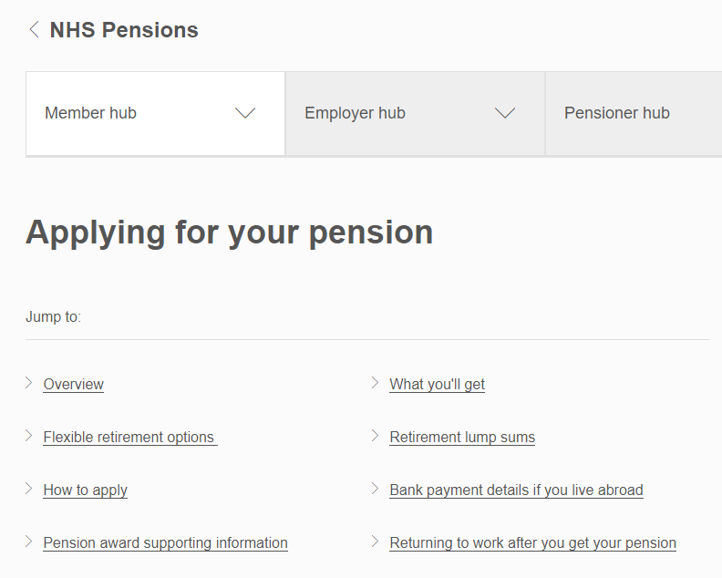
8. Saving enough to stop work
Further information
www.nhsbsa.nhs.uk/member-hub/applying-your-pension
https://www.retirementlivingstandards.org.uk/
www.gov.uk/check-state-pension

Slide 55
NHS Pension Scheme
The value of membership
9. Ways to increase your benefits
July 2023

Slide 56
Buying more pension
Additional pension
(“AP”)
Cost depends on
Your age
Buy extra guaranteed income
How many blocks you buy
In blocks of £250 per year
If you buy a survivor’s pension
You can pay by
A single lump sum
Monthly (via payroll)
Paid every year for life
Eligible for income tax relief
Notes:
Purpose of slide: To discuss the option of buying more pension in the Scheme through the “Additional Pension” option.
Notes for delivery: Explain what Additional Pension is, what it costs and how employees can pay.
Points to note / warnings: Correct at time of writing – speakers should ensure options and availability across the schemes are correct at time of presenting. Consider impact on Annual and Lifetime Allowances.

Slide 57

Making extra pension savings
Additional voluntary contributions (“AVCs”)
Size of your savings depends on
How much you pay in
Held separately from your main scheme benefits
Investment returns
In a pension saving account
Management charges
You can pay by
AVCs
Single lump sums
Monthly (via payroll)
Choose how you receive it
Notes:
Purpose of slide: To discuss the option of paying Additional Voluntary Contributions.
Notes for delivery: Explain what AVCs are, the cost, what it provides (AVC pot – not guaranteed pension) and how employees can pay.
Points to note / warnings: Correct at time of writing – speakers should ensure options and availability across the schemes are correct at time of presenting. Consider impact on Annual and Lifetime Allowances.

Slide 58
Earlier retirement age
(for 2015 Scheme only)
Early retirement reduction buyout (“ERRBO”)
Cost depends on
Your age
Reduce your Normal Pension Age (“NPA”) by up to 3 years
Number of years’ reduction
You can pay by
Monthly (via payroll)
An example
NPA in new scheme is 68
Take out a 3-year ERRBO
Same pension paid from 65
Paid every year for life from NPA
Paid every year for life from earlier age
Notes:
Purpose of slide: To discuss the option of paying for a reduced Normal Retirement Age – called the “Early Retirement Reduction Buy out”.
Notes for delivery: Explain what it is, what it costs, and how employees can pay. Only available for 2015 Scheme members, window to apply each year. Only take effect when contributions are being paid (i.e. cannot pay retrospectively).
Points to note / warnings: Correct at time of writing – speakers should ensure options and availability across the schemes are correct at time of presenting. Consider impact on Annual and Lifetime Allowances.

Slide 59
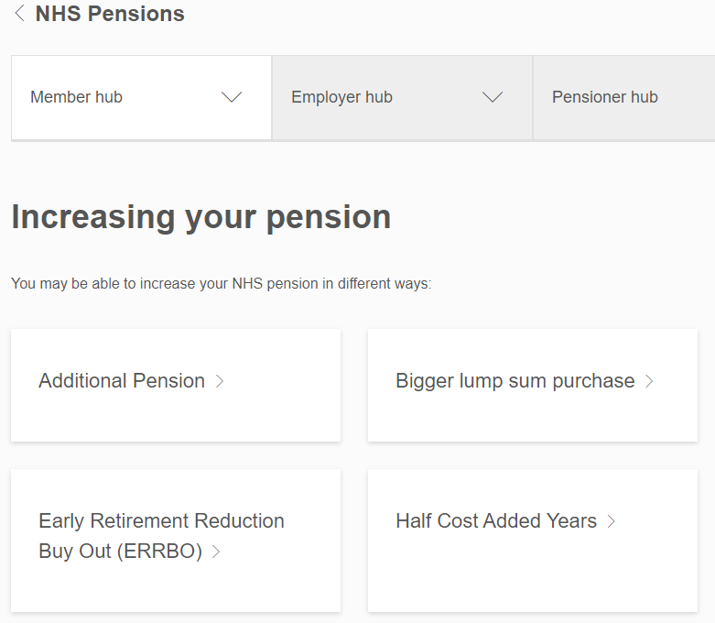
9. Ways to increase your pension
Further information
www.nhsbsa.nhs.uk/member-hub/increasing-your-pension

Slide 60
NHS Pension Scheme
The value of membership
10. Pensions tax
July 2023

Slide 61
The Annual Allowance (“AA”)
Limit on tax-relieved pension savings in one year for all pension savers, not just NHS
Headline AA is currently £60,000 pa
If you breach the AA, you may be subject to a tax charge
A tax charge will fall due on this “excess accrual” unless there is sufficient “carry-forward”
Value of benefits earned over the year
“Pension Input Amount”
Excess
Annual Allowance
Notes:
Purpose of slide: To explain when this tax charge applies – i.e. when individuals exceed the Annual Allowance in a single tax year.
Notes for delivery: Breaching the AA does not necessarily mean that a tax charge applies as individuals may have unused allowance (or “carry forward”) from previous years to offset the excess savings.
Speaker should consider offering audience examples of how excess pension savings can occur – for example a spike in pensionable pay due to promotion for an employee in one of the final salary sections / buying additional pension etc.
Points to note / warnings: The AA applies to all UK pension schemes – it is not NHS Pension Scheme specific. Annual Allowance correct at time of writing (2023/24).

Slide 62
Testing against the Annual Allowance
NHS
Pension
Scheme
“Defined Benefit”
DB pension earned over the year (in real terms)
Pension built up
at start of year
(uplifted for inflation)
Pension built up at end of year
Factor of 16
Value of one year’s DB pension saving
AVCs
“Defined Contribution”
DC pension earned over the year
Gross contributions paid
Value of one year’s DC pension saving
Notes:
Purpose of slide: To explain how pension saving is valued for Defined Benefit pension schemes (like in the NHS) and Defined Contribution pension schemes (like AVCs).
Notes for delivery: Individuals should be careful if they have pension savings elsewhere – as limit applies to ALL pension savings, not just in the NHS Pension Scheme. (State Pension exempt from this.)
Points to note / warnings: Not NHS Pension Scheme specific – applies to all UK pension saving.
If appropriate, could provide further detail on 1995 Section benefits where the change in the value of the lump sum is also included in the value of DB pension saving.

Slide 63
Breaching the Annual Allowance
Value of one year’s
pension saving
DB + DC
£60,000*
plus carry forward from last 3 years
(*ignores any tapering)
Excess pension savings
Notes:
Purpose of slide: To measure the value of pension saving against the Annual Allowance to determine whether there is any excess.
Notes for delivery: Carry forward is only mentioned at a very high level. Could use this prompt to explain further.
Points to note / warnings: Annual Allowance correct at time of writing (2023/24).

Slide 64
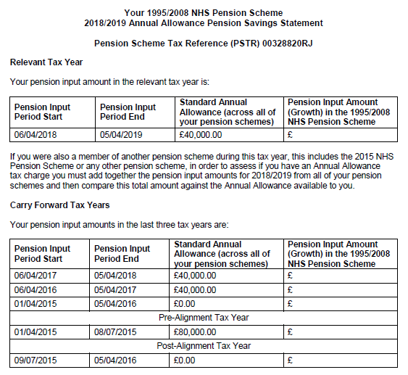
Keeping track of the Annual Allowance
The Scheme will send you a statement if you exceed the AA
Your statement will show the value of your pension savings for the latest tax year
and the previous 3 years, enabling you to work out your unused AA to carry forward.
The NHS Pension Scheme will ONLY inform you about the value of your NHS benefits. You need to also consider benefits you might be building up outside this scheme.
Notes:
Purpose of slide: To explain that the Scheme calculates the value of pension saving on the behalf of members and writes to those impacted.
Notes for delivery: The previous slides provide background for the calculations, which are carried out by the Scheme administrators.
The example statement can be used to illustrate what is shown on statement.
Points to note / warnings: Only NHS benefits will be set out on Scheme statements – employees will also have to consider any further pension savings outside of the Scheme.
Correct at time of writing – speakers should ensure options and availability across the schemes are correct at time of presenting.

Slide 65
Options for paying an Annual Allowance tax charge
Excess pension savings
AA tax charge
= Excess pension savings × relevant rate(s) of income tax
Taxable income
AA tax charge can be paid by the…
(1)…scheme member
(2)…pension scheme
Self-assessment tax return
“Scheme Pays”
Paid out of post-tax income
Tax charge increased with interest
Benefits unchanged
Benefits reduced on retirement
Notes:
Purpose of slide: To explain how tax is applied to excess pension saving (worked out on previous slide), and the options for paying this tax charge.
Notes for delivery: The AA tax charge can be paid either directly (through a tax return), or through the Scheme when certain criteria are met (by “Scheme Pays” – reducing pension benefits).
Guidance and examples are available on the NHS Business Services Authority website.
Points to note / warnings: Correct at time of writing – speakers should ensure options and availability are correct at time of presenting.
Employers are not authorised to provide advice on which option is the best one to choose. It is the employee’s responsibility to seek independent financial advice if required.

Slide 66
Using Scheme Pays to pay an Annual Allowance tax charge
1995/2008 Scheme and 2015 Scheme
AA tax charge
Held as a notional negative DC fund (like a loan) on your record
Interest is applied until you retire or transfer out
Converted to an annual pension amount at retirement
Deducted from your NHS pension at retirement
NHS AVC Scheme
AA tax charge
Deducted from your existing AVC fund
Notes:
Purpose of slide: To build from the previous slide, explaining how a tax charge paid settled using Scheme Pays eventually results in reduced benefits at retirement.
Notes for delivery: This slide only looks at Scheme Pays and breaches of the Annual Allowance across different schemes is settled by the correct scheme.
Guidance and examples are available on the NHS Business Services Authority website.
Points to note / warnings: Correct at time of writing – speakers should ensure that the Scheme Pays approach hasn’t changed.

Slide 67
Scheme Pays – Example
1995 Section only
AA tax charge
AA charge of £26,000
Negative notional DC account (like a loan) held on member’s record
Notional DC Fund: (£26,000)
Member retires
Retires at age 60
Interest is applied to the notional negative DC fund to retirement
Notional DC Fund: (£35,200)
Negative DC fund is converted to a deduction to member’s benefits
Reduction in 1995 Section benefits:
Pension = £35,200/23.90 = £1,472.80 pa
Lump sum = £1,472.80 x 3 = £4,418.40
Notes:
Purpose of slide: An example to illustrate how Scheme Pays can be used when an Annual Allowance breach has occurred in the 1995 Section only.
Notes for delivery: This slide only looks at Scheme Pays and a breach of the Annual Allowance in the 1995 Section only.
Guidance and examples are available on the NHS Business Services Authority website.
Points to note / warnings: The Scheme Pays factors are correct at time of writing.

Slide 68
Scheme Pays – Example
1995/2008 Scheme and 2015 Scheme
Total AA tax charge = £12,500
1995 Section
2015 Scheme
Notional DC Fund: (£10,500)
Notional DC Fund: (£2,000)
Retires at age 62
Retires at age 62
Notional DC Fund at 62 (£12,000)
Notional DC Fund at 62 (£2,285)
Reduction in 1995 Section benefits:
Pension = £12,000/22.90 = £524 pa
Lump sum = £524.02 x 3 = £1,572
Reduction in 2015 Scheme benefits:
Pension = £2,285/19.90 = £115 pa
Notes:
Purpose of slide: An example to illustrate how Scheme Pays can be used when an Annual Allowance breach has occurred across both the 1995/2008 Scheme and the 2015 Scheme.
Notes for delivery: This slide only looks at Scheme Pays and a breach of the Annual Allowance in both the 1995 Section and the 2015 Scheme.
Guidance and examples are available on the NHS Business Services Authority website.
Points to note / warnings: The Scheme Pays factors are correct at time of writing.

Slide 69
The AA can be less than £60,000
Test 1
“Threshold income”
Annual Allowance is £60,000
No
Is your taxable income*
more than £200,000?
(*not just employment earnings, exclude pension contributions)
Yes
Test 2
“Adjusted income”
Adding on the value of your pension savings, does this sum to more than £260,000?
No
Annual Allowance is lower than £60,000
Yes
Notes:
Purpose of slide: To explain that the Annual Allowance of £60,000 may be less for higher earner, which increases the likelihood of a tax charge applying.
Notes for delivery: Explain threshold and adjusted income are only known after the end of the tax year, and that they do not only include taxable earnings from NHS employment.
Points to note / warnings: Limits and tests correct at time of writing (2023/24).

Slide 70
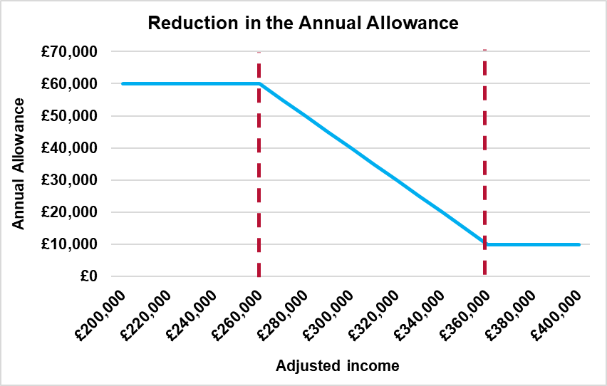
The tapered Annual Allowance
Each £2 of adjusted income above £260,000 reduces the AA by £1
With a minimum AA of £10,000
Adjusted income | Annual Allowance
Less than £260,000 | £60,000
£280,000 | £50,000
£300,000 | £40,000
£320,000 | £30,000
£340,000 | £20,000
More than £360,000 | £10,000
Notes:
Purpose of slide: To explain how the Annual Allowance reduces (or ‘tapers’) for employees if both tests on previous slide are breached.
Notes for delivery: The Annual Allowance can taper down to a minimum of £10,000.
Points to note / warnings: Amounts correct at time of writing. Does not include any information on the Money Purchase Annual Allowance.

Slide 71
The Lifetime Allowance (“LTA”)
Limit on tax-relieved pension savings over a lifetime for all pension savers - not just NHS
LTA is currently £1,073,100 (2023/24 tax year)*
If you breach the LTA, you were previously subject to a tax charge
Total value of benefits across all scheme
Excess
A tax charge would fall due on these “excess benefits”
*It was announced in the March 2023 Budget that LTA tax charges will not apply in 2023/24 and the LTA is scheduled to be abolished from 2024/25.
Lifetime Allowance
Notes:
Purpose of slide: To explain when this tax charge applies – i.e. when individuals exceed the Lifetime Allowance.
Notes for delivery: Speaker should consider offering audience examples of how excess pension savings can occur.
Points to note / warnings: The LTA applies to all UK pension schemes – it is not NHS Pension Scheme specific. LTA for 2023/24 correct at time of writing.

Slide 72
Testing against the LTA
*only when benefits are taken*
NHS
Pension
Scheme
“Defined Benefit”
Actual pension taken at retirement
Factor of 20
Cash lump sum
(at face value)
Value of DB
AVCs
Face value of cash taken
Value of DC
Or, value of savings when annuity bought
Or, value of savings allocated to drawdown
Notes:
Purpose of slide: To explain how pension saving is valued for Defined Benefit pension schemes (like in the NHS) and Defined Contribution pension schemes (like AVCs).
Notes for delivery: Individuals should be careful if they have pension savings elsewhere – as limit applies to ALL pension savings, not just in the NHS Pension Scheme. (State Pension exempt from this.)
Points to note / warnings: Not NHS Pension Scheme specific – applies to all UK pension saving.
If appropriate, could provide further detail on NHS Pension Scheme benefits.

Slide 73
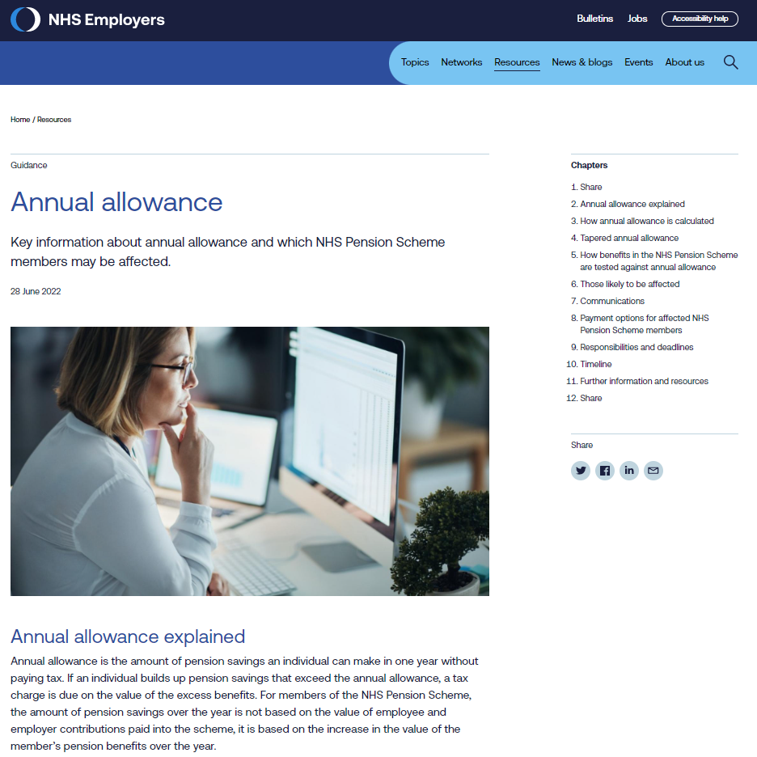
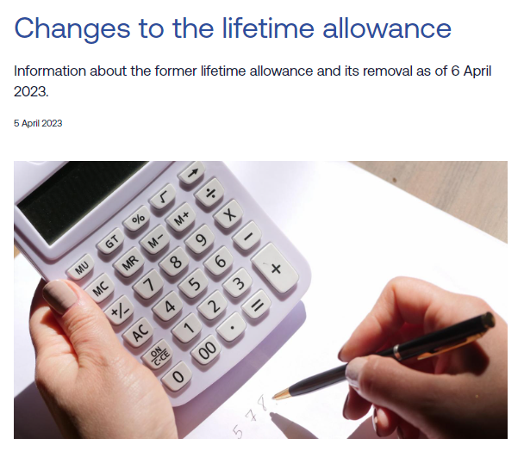
10. Pensions tax
Further information
www.nhsemployers.org/publications/annual-allowance
www.nhsemployers.org/publications/changes-lifetime-allowance

Slide 74
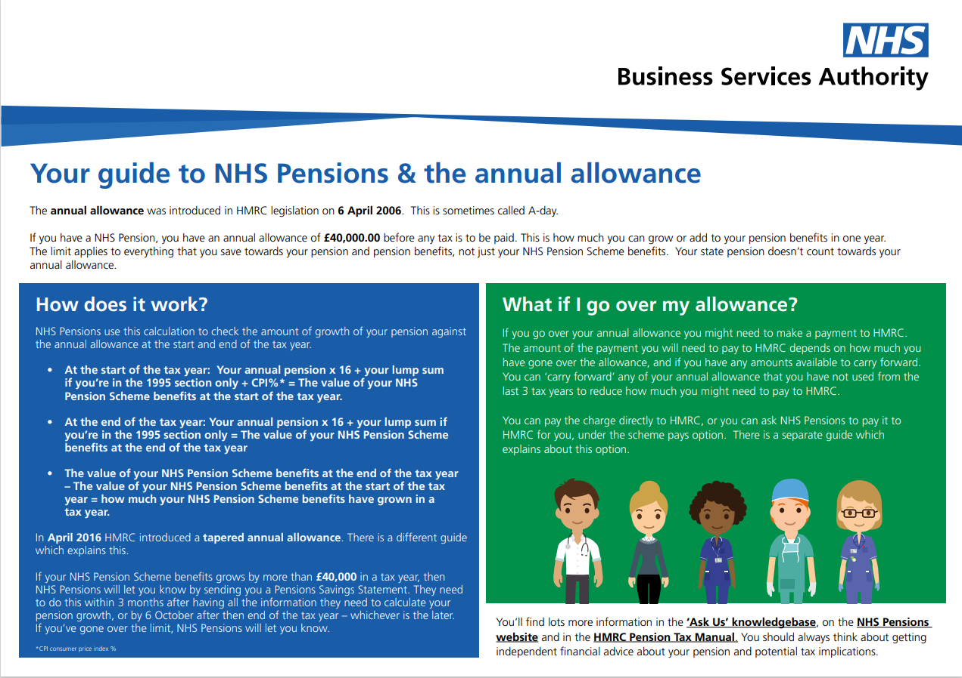

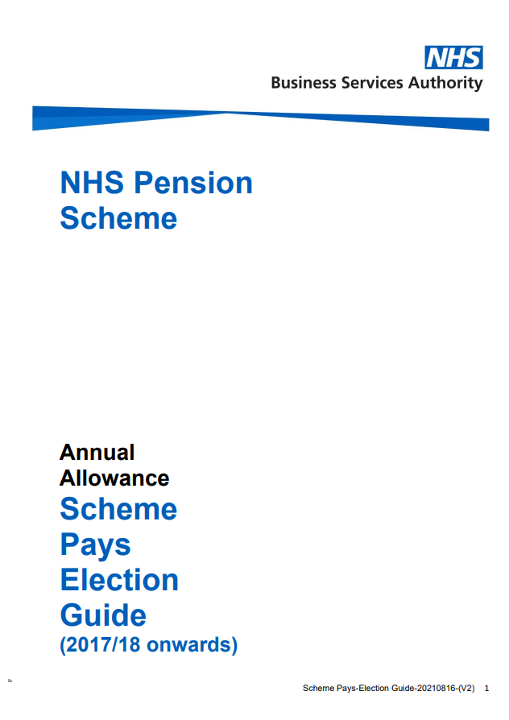
10. Pensions tax
Further information
www.nhsbsa.nhs.uk/member-hub/annual-allowance
www.nhsbsa.nhs.uk/member-hub/lifetime-allowance

Slide 75
Disclaimers and warnings
The content of this presentation is designed to assist NHS employers in providing their employees with helpful information regarding pension saving.
None of the material provided is intended as financial advice or recommendation and NHS Employers accept no liability arising from any use of the presentation.
If employees require specific advice or help regarding their financial planning, they should contact an Appropriately Qualified Financial Adviser.
This presentation has been created using PowerPoint Office 365. Spacing and formatting may change if a different version is used. We recommend that users check the presentation before delivery to spot and correct any format changes.
NHS Employers cannot take responsibility for any amendments, edits and additions made from this point forward by users.
We have taken every care in the preparation of these materials, but it is not binding. If any error or omission should subsequently be discovered, the scheme regulations take precedence.
We understand the information, illustrations and figures quoted to be accurate at the time of writing (July 2023). However, over time these will become out of date – for example as tax bands or contribution rates change over time, new legislation or tax treatments are introduced or altered, and new financial products and systems are introduced. We take no responsibility in ensuring the materials are kept up to date.
Any figures set out in this presentation are intended as illustrations only.
The benefits provided by the NHS Pension Scheme are governed by Regulations. More details of the benefits provided by the Scheme can be found on the Scheme website.
Some of the information provided is “opinion based”, for example setting out “rules of thumb” or the “value of the State Pension”. The materials covering these sections are therefore not intended to be statements of fact. Very different viewpoints or opinions could reasonably be taken, and each individual will be different. Specifically, these opinions are not intended to direct individuals to take a particular course of action but are provided as generic ideas to be considered.
Notes:
Purpose of slide: Legal disclaimer and warning slide.

