Slide 1

University Hospital Tees
Navigating Change through an OD-lens
Rachel De Silva - Head of Culture, Leadership, Education & Development
Dan Fawkes – Head of Organisational Learning and Improvement

Slide 2
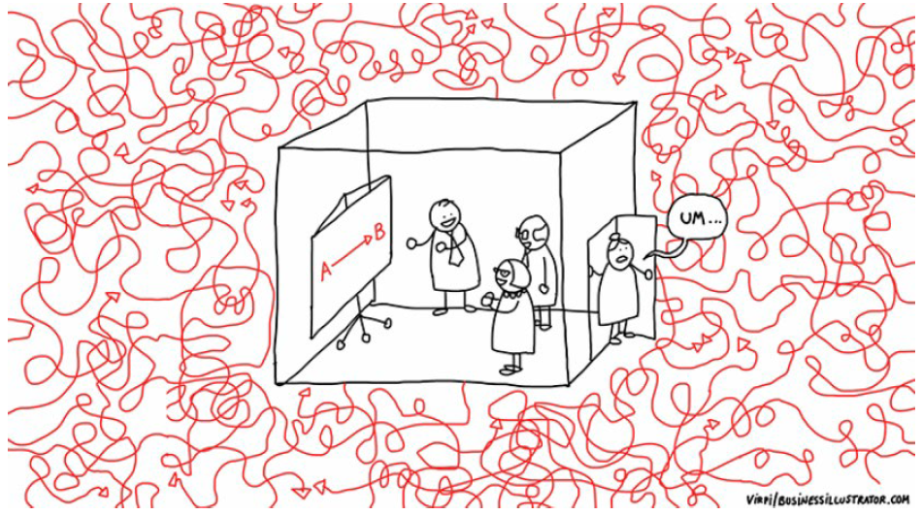
VISION
Creation of a truly collaborative and integrated service across all our People functions, that builds a fully engaged, inclusive and high performing workforce that lives our values and behaviours.
In the meantime.....

Slide 3
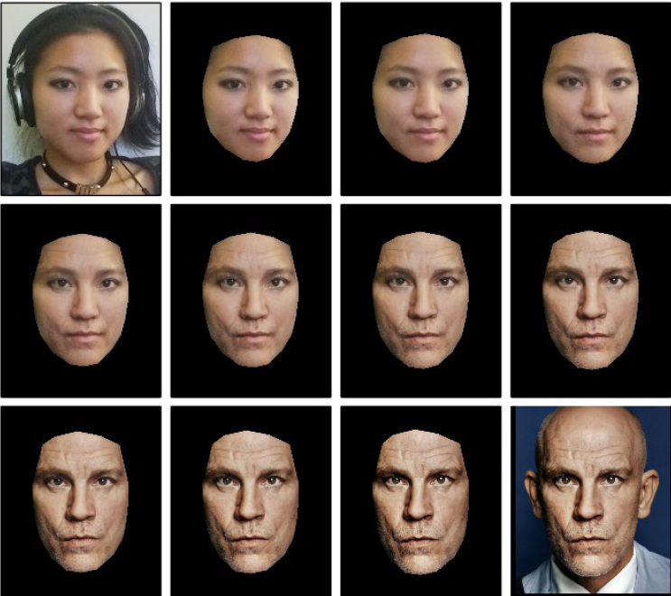
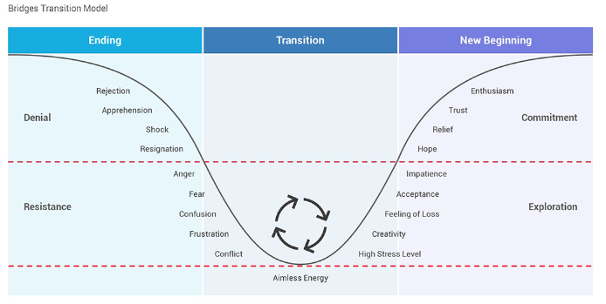
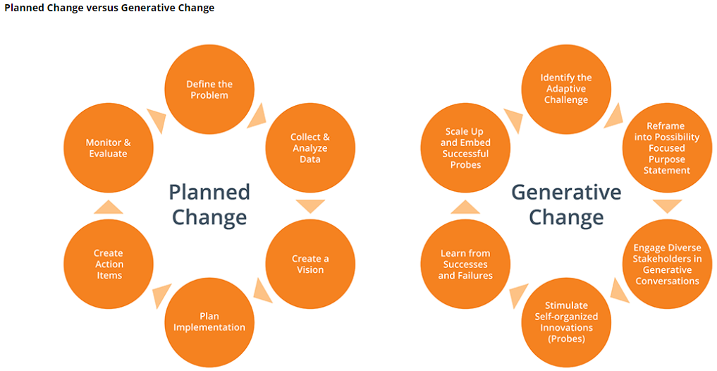
What we know about change

Slide 4
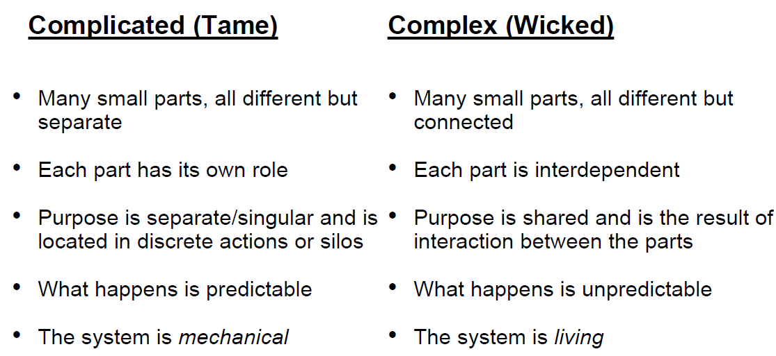
What we know about our system(s)

Slide 5
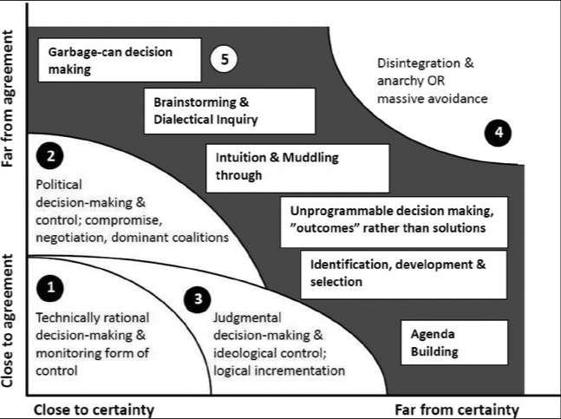
More on complexity
The experience of working in OD
A buffer between simplicity and anarchy
A sense making function
A navigation aid (with a heart)
…..all the while we are going through this ourselves at the same time.
Ralph Stacey, Complexity Theory

Slide 6
How it's been for us...
Early engagement and involvement is key
Transparent and consistent communication is important
Trust/faith and 'agency' is helpful

Slide 7
Current state & next steps...
5 x Clinical Boards
  Tri-team led (Medic/Nurse/Corporate)
Blended OD support
  Cross-Group workforce / shared models of support
  Mixed methodologies approach (1:1 / team / service-level support)
Keep going – flex vs hold-the-line / measure & share / celebrate

Slide 8
Questions / Offers
What else would be helpful to explore?
What (if anything) might you offer those currently navigating change?

