Slide 1
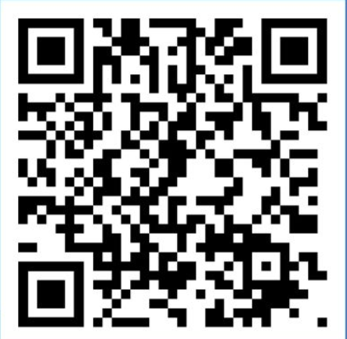

Share your views on faith
and belief in the workplace
Take part in phase two of this national survey to help the NHS
understand:
how staff feel about religious expression in the workplace
      the impact faith and belief staff networks have on staff wellbeing
      the importance of access to quiet spaces.
      Conducted by NHS Employers in partnership with the University of Surrey, this survey is open to anyone working in the NHS from any background, with or without a faith or belief.
      The survey is anonymous and should take about 10 minutes to complete and
      closes on 31 March 2025.
      If you have already completed this survey in 2023 then there is no need to complete it again.
Take the survey

