Slide 1

How to update Military Status on your Electronic Staff Record (ESR)
A guide to updating your armed forces status on ESR.
Welcome to this short guide on how to update your military status on ESR (your Electronic Staff Record)

Slide 2
Members of the Armed Forces Community
Updating your ESR helps ESHT to tailor support for members of the armed forces community, this includes:
Veterans
Current Serving Members
Reservists
Families
Updating your ESR helps ESHT to tailor support for members of the armed forces community, this includes:
veterans, those currently serving, reservists and their family members.

Slide 3
Why It Matters?
Workplace Support: Provides tailored resources for employment and wellbeing.
National Reporting: Contributes to MOD and NHS data collection on the Armed Forces community.
So why does this matter? It helps to ensure ESHT provides the appropriate support to their colleagues. It also helps us to contribute to data collection for the NHS and the MOD.

Slide 4
Steps to update Military Status on ESR
1. Log in to ESR Portal using your login credentials.
2. Navigate to My Personal Information, select your name and select update my information.
3. Select on the wellbeing tab to locate 'Armed Forces Status.’
4. Select Your Status:
- Veteran
- Serving Member
- Reservist
5. Save to confirm changes.
These are the steps you need to take to update your details on ESR.

Slide 5
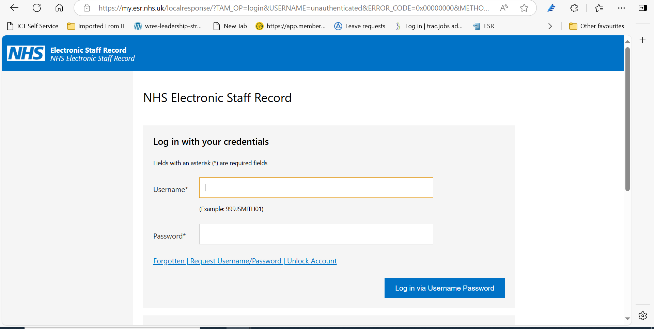
Step one
Step one - Log in to the ESR Portal using your login credentials.

Slide 6
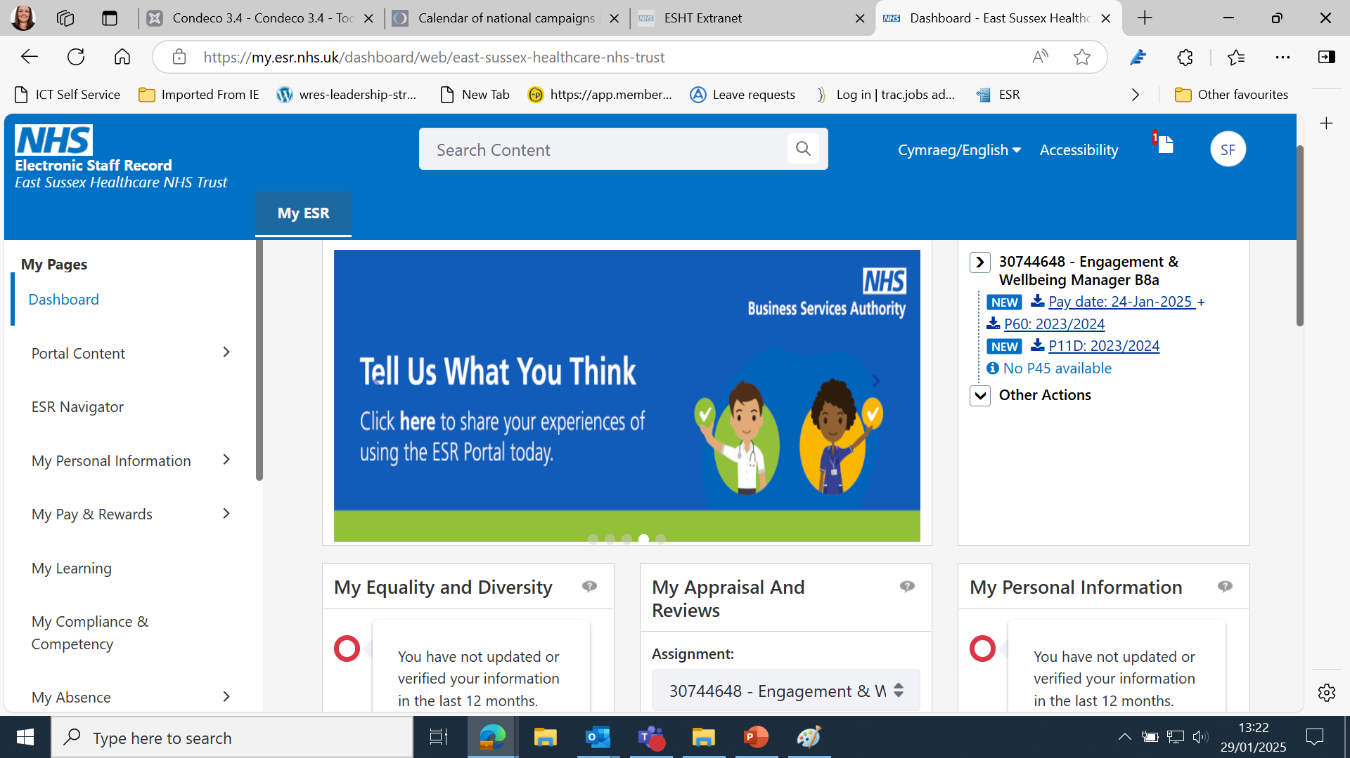
Step two
Details of job role and payslips here.
Step two. Navigate to My Personal Information….

Slide 7
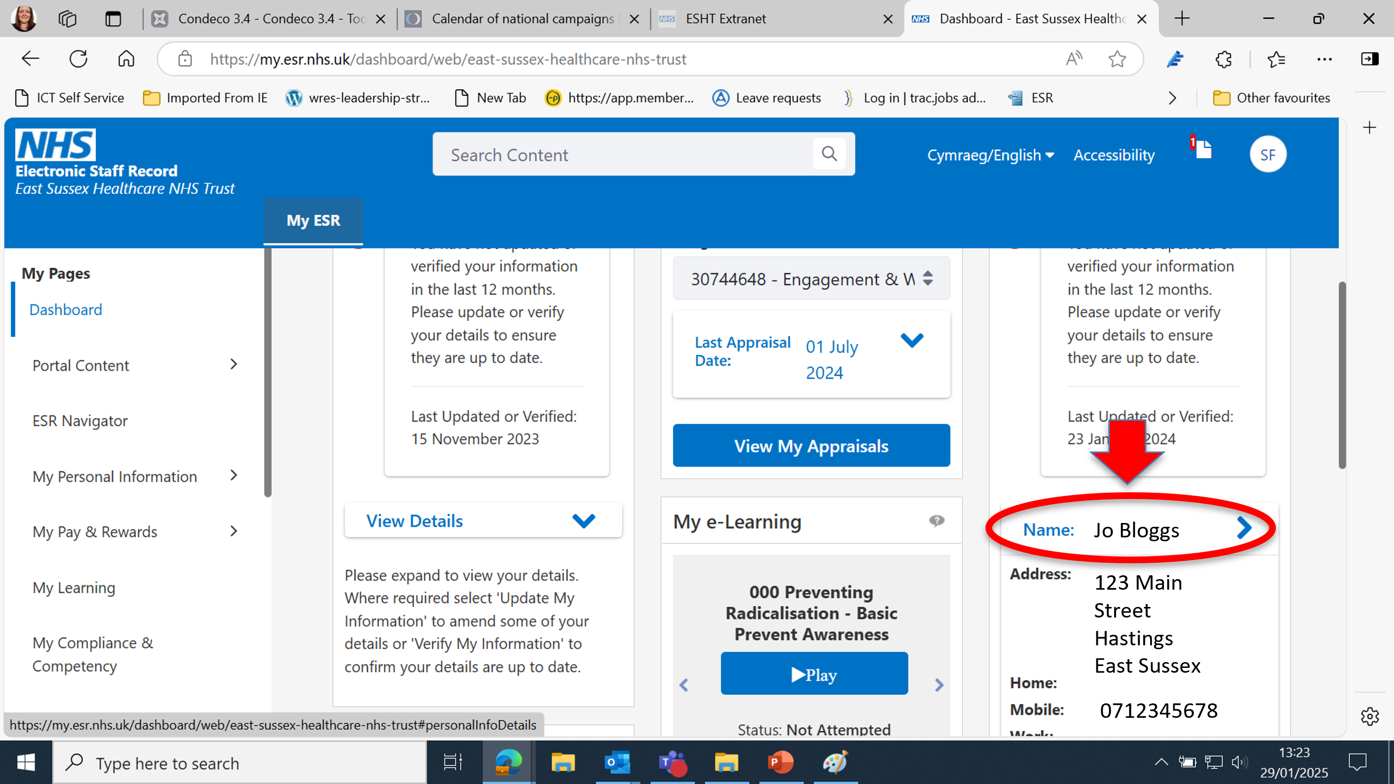
….Select your name….
Step two

Slide 8
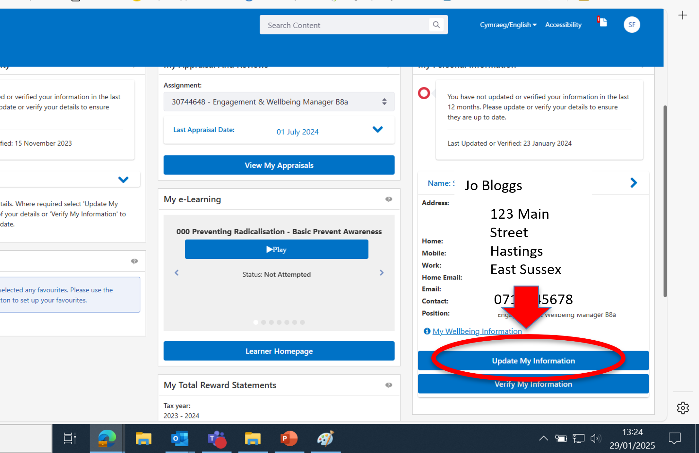
…and select Update My Information
Step two

Slide 9
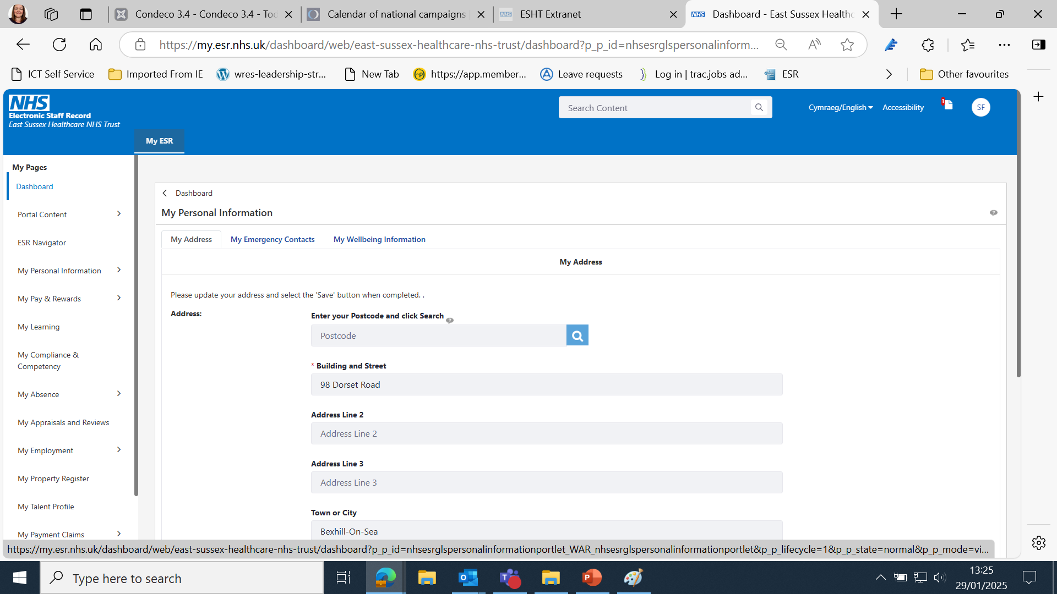
Step three
123 Main Street
Hastings
Step three -Select My Wellbeing Information

Slide 10
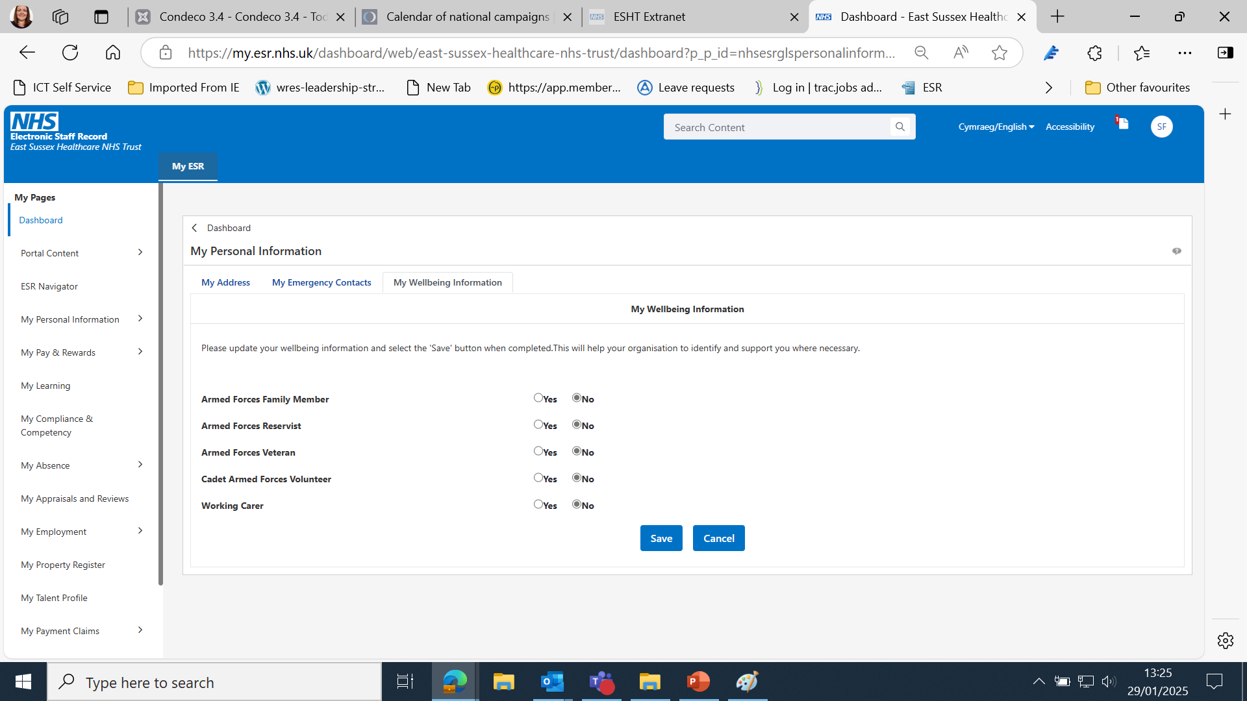
Step four
Step 4 - Update your Armed Forces Status

Slide 11
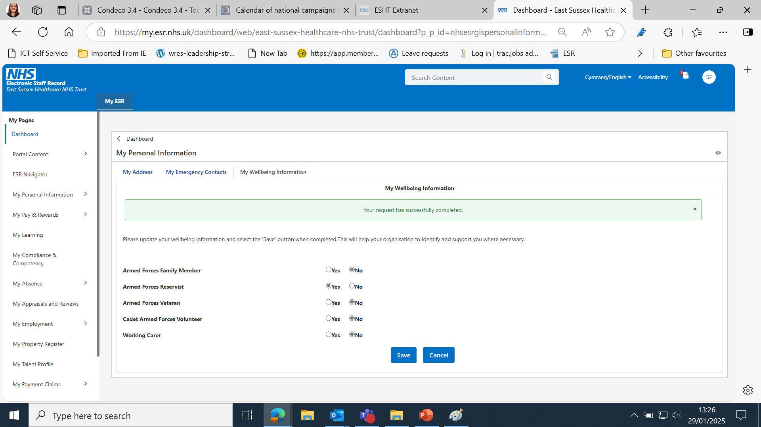
Step five
Step five -Press save and you will see a confirmation

Slide 12
Support and Resources
For further advice and support go to the extranet page ‘Armed forces communities’
Additional Training: MyLearn modules on Armed Forces Awareness.
For further help and support go to the extranet page on Armed Forces Communities or speak to your line manager.

