Slide 1


Asbestos – what you need to know
Notes:
Good [morning/afternoon], everyone.
Thank you for taking the time to join this short session.
Today, I want to talk to you about asbestos—what it is, why it matters, and what you need to know

Slide 2


What you need to know
What the legal duties are for your employer to identify and manage asbestos risks
What the risks of exposure to asbestos are
If asbestos is present in your workplace and the specific locations of asbestos containing materials in the areas you work in
Not to disturb any asbestos containing materials
What you should do if you believe asbestos may have been accidentally disturbed
This presentation does not replace a UKATA asbestos awareness training for specific staff groups
Notes:
This presentation does not replace a UKATA asbestos awareness training for specific staff groups.
1. Legal Duty of Care
Under regulations like the Control of Asbestos Regulations 2012 (UK), employers have a legal obligation to:
Identify and manage asbestos risks.
Inform anyone who may come into contact with asbestos-containing materials (ACMs), including employees, contractors, and maintenance workers.
This includes informing workers who occupy buildings of the specific locations of ACMs in the rooms or areas they use, as well as not to disturb them and reporting any accidental damage promptly.
2. Health Risks from Asbestos Exposure
Asbestos exposure can cause serious diseases, including:
Mesothelioma
Asbestosis
Lung cancer
3. Risk Assessment and Training
Employees need to know about asbestos to:
Participate in risk assessments.
Receive asbestos awareness training if their work could disturb ACMs or if they supervise or influence such work.
Understand emergency procedures if asbestos is accidentally disturbed.
4. Ethical Responsibility
Transparency builds trust. Informing employees shows that the employer values their wellbeing and is committed to creating a safe working environment.
5. Preventing Accidental Exposure
Many asbestos-related incidents occur because workers unknowingly disturb materials. Clear communication helps prevent:
Accidental damage to ACMs.
Contamination of workspaces.
Exposure to others, including vulnerable individuals.

Slide 3
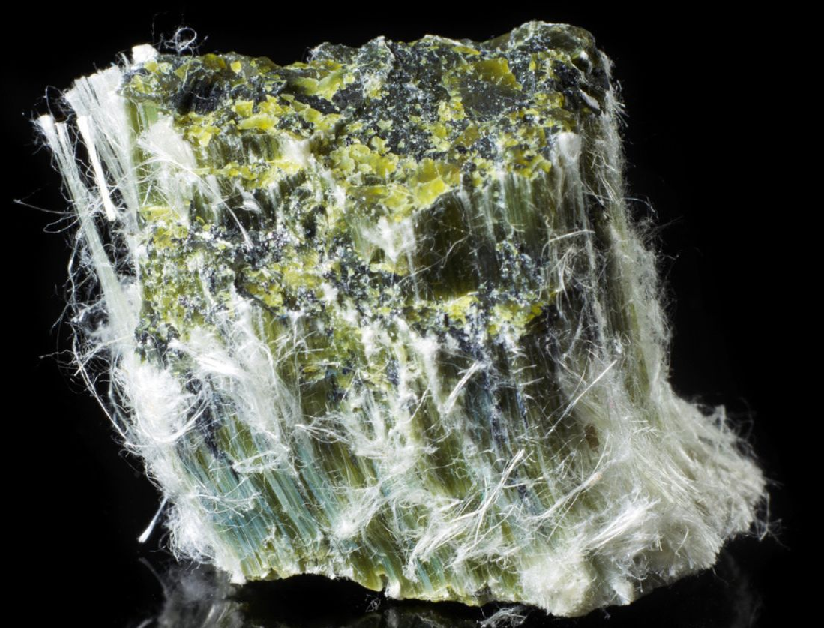
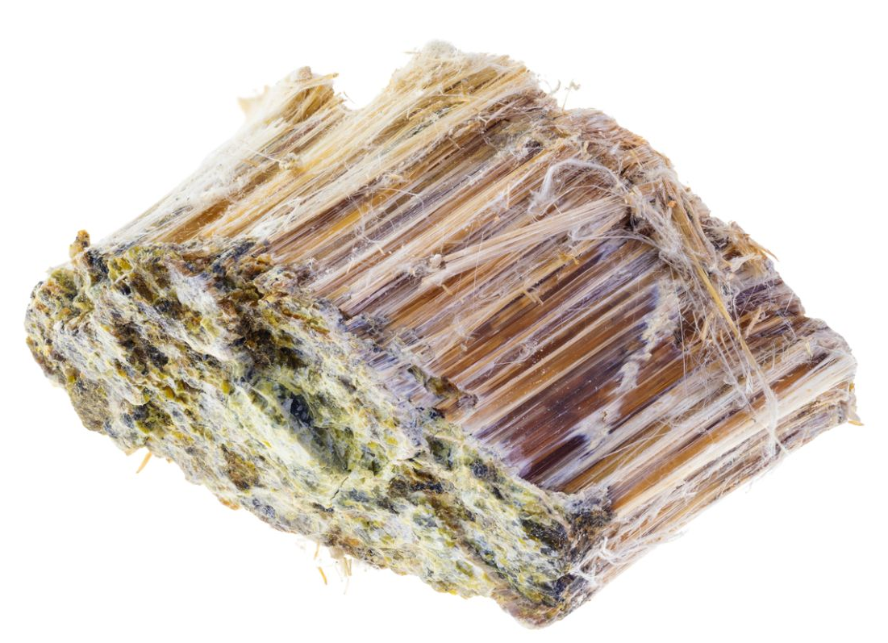
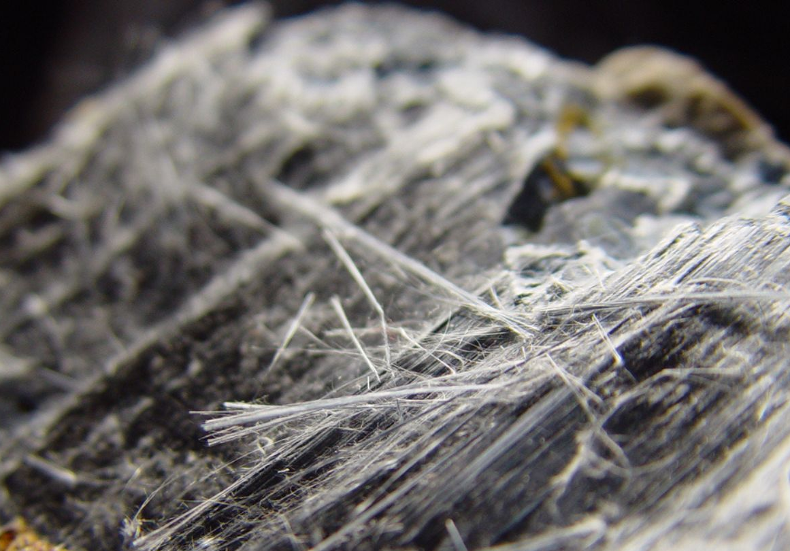
Understanding Asbestos
Asbestos is a naturally occurring fibre widely used in the construction and refurbishment of buildings before 2000. It was also used in plant and machinery. It is resistant to heat, fire, chemical and biological breakdown.
There are three main types of asbestos:
Did you know?
Asbestos was banned in the UK in 1999, but many buildings constructed prior to 2000 still contain it
Chrysotile/White asbestos
(most commonly used)
Amosite/Brown
asbestos
Crocidolite/Blue
asbestos
Notes:
Asbestos is a naturally occurring mineral once widely used in building materials for its strength, fire resistance, and insulation properties.
- Common in buildings constructed or refurbished before the year 2000.
Exposure to asbestos can cause asbestos related lung cancer - mesothelioma, asbestosis and pleural thickening
There is a latency period of between 10-50 years after exposure to asbestos and asbestos related disease occurring
Risk of exposure is to anyone in a building not just workers who undertake maintenance/ intrusive building work
There is specific legislation to manage asbestos to prevent harm to anyone who works on the building or to building occupants. Control of Asbestos Regulations 2012 which places a ‘duty to manage’ on people responsible for non-domestic premises.

Slide 4
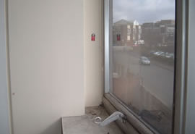
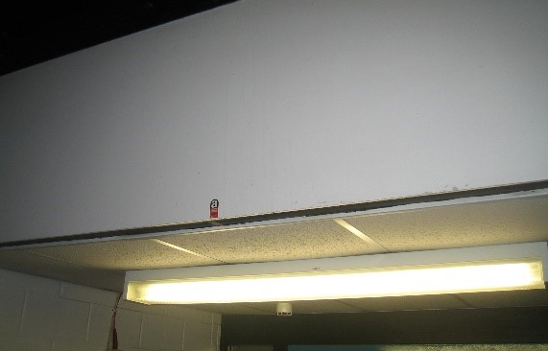
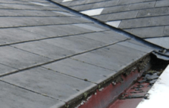
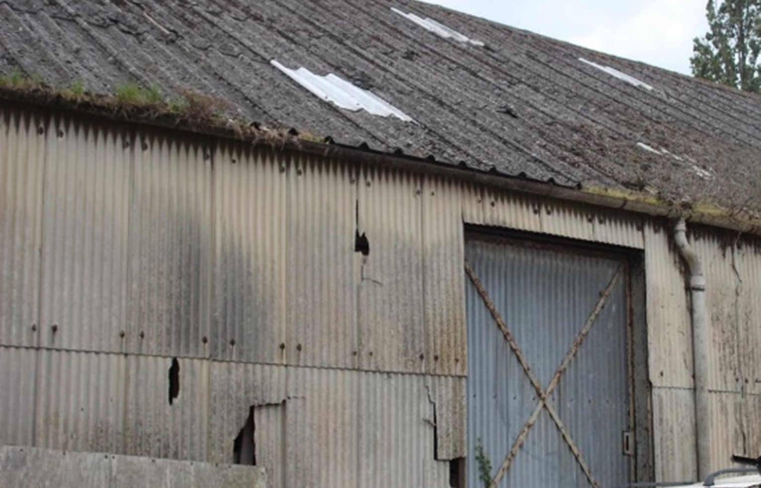
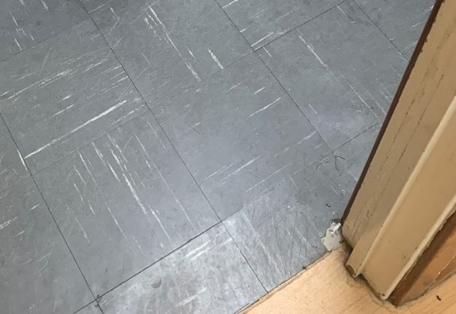
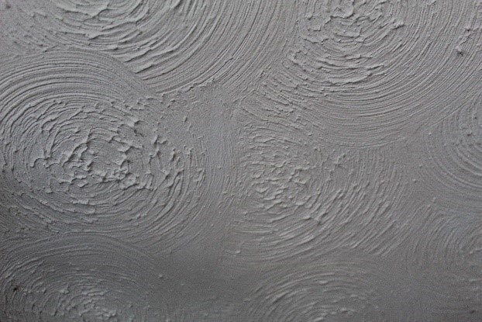
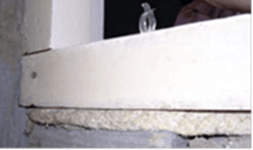
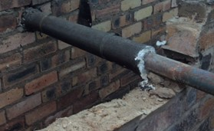
Examples of where asbestos may be found
AIB panel adjacent to window
AIB bulkhead panel in corridor
Asbestos cement roof tiles
Asbestos roof tiles and cement downpipe
Asbestos vinyl floor tiles
Asbestos textured coating
Amosite asbestos rope packing beneath riser door frame
Damaged pipe lagging
Notes:
Example photos of where asbestos can be found inside and outside buildings

Slide 5
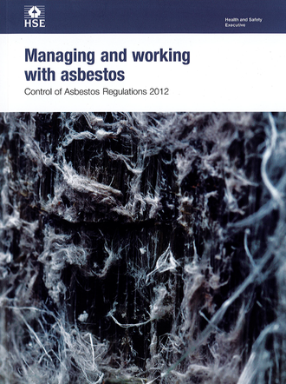
Legal requirements to manage asbestos
Locate and identify asbestos
Monitor the condition of asbestos
Develop an asbestos register and risk assessment
Prepare a detailed asbestos management plan - monitor and review it
Identify and manage licenced and non-licenced work
Provide information on asbestos to workers who carry out work on buildings which may disturb/damage asbestos
Provide information, instruction and training to staff
Consult with trade union safety representatives
Legislation: Control of Asbestos Regulations 2012
Approved Code of Practice and Guidance: L143
The regulations require duty holders to actively manage asbestos in buildings:
Notes:
Outline the legislation specific to asbestos – Control of Asbestos Regulations 2012
The Control of Asbestos Regulations 2012 and The Control of Asbestos Regulations (Northern Ireland) 2012 require asbestos to be managed in non-domestic premises. They outline the requirement on dutyholders to identify the location and condition of asbestos in non-domestic premises and manage the risk to workers and building occupants.
The action required depends on your role. Building owners, landlords and organisations who have responsibility for the building’s maintenance or repair have a legal duty to manage asbestos in the building – ‘the dutyholder ’.
EMPLOYERS CAN ADD IN ADDITIONAL INFORMATION
e.g.
who carries out work on the buildings
who in the organisation is responsible for managing asbestos
how they check asbestos arrangements and work with other dutyholders in buildings outside their control where staff work
identify who manages asbestos internally and who carries out building work
Add hyperlink to webpage - The duty to manage asbestos in buildings: Overview - HSE

Slide 6
Are you at risk?
The presence of asbestos alone should not be a cause for concern.
Asbestos only becomes a risk to human health when fibres are released into the air and breathed in.
You shouldn’t come into contact with asbestos during your normal working activity, but this presentation will give you information on what to do if you have concerns.

Slide 7
What you should know about your workplace
If asbestos containing materials have been identified in certain areas of the building, this information will be in the asbestos register [provide examples]
These materials should be good condition and pose no immediate risk. [if work is taking place to protect or remove asbestos this could be added in here]
[employer to add here your arrangements to provide information on the specific locations of ACMs in the rooms/areas in use]
An asbestos management plan is in place to ensure asbestos containing materials remain safe and undisturbed
Regular condition inspections are carried out by qualified professionals
Any work which carries a risk of disturbing asbestos is very carefully planned and managed through [the estates and facilities team/relevant team name]

Slide 8
We have conducted a full asbestos survey of the building(s) to identify asbestos containing materials which could be damaged or disturbed during normal occupancy, and assessed their condition
We maintain an Asbestos Register and Management Plan
Anyone who works on the fabric of the building including staff and contractors are informed of the presence of asbestos containing materials
Thorough risk assessments are carried out before work starts by properly trained people
Work is closely monitored by [insert name of team]
Informing you of specific locations of asbestos containing materials in the rooms or areas you use and what to do in the event of accidental damage
What we are doing to keep you safe
Notes:
Notes:
Following an asbestos survey, any identified asbestos-containing materials (ACMs) are assessed using a structured risk assessment process to determine how they should be managed to prevent exposure and protect staff, patients, contractors and visitors. The first stage is the material assessment, which evaluates the ACM's ability to release asbestos fibres if disturbed. This assessment considers four key factors: the product type, the condition or extent of damage, the surface treatment, and the type of asbestos present. Materials that are more friable, damaged or poorly protected will generally receive a higher material assessment score because they have a greater potential to release fibres.
However, the material assessment alone does not determine the overall level of risk or the priority for action. A priority assessment is also undertaken to evaluate the likelihood of people being exposed to the asbestos. This considers factors such as the location and accessibility of the ACM, how the area is used, occupancy levels, the activities taking place within the area, and the likelihood that maintenance or other work could disturb the material.
The material assessment and priority assessment are then combined to produce an overall risk assessment, which helps determine the most appropriate management response. This may include routine monitoring and inspection, encapsulation, repair, restricted access arrangements, additional information and labelling, or removal of the ACM where necessary. The purpose of this risk-based approach is to focus management actions on asbestos materials that present the greatest potential for exposure, ensuring workers and others are protected from the risks associated with asbestos fibres

Slide 9
1
Do not touch or disturb any materials in the areas you occupy that have been identified in the asbestos register. These may be marked with asbestos warning labels, but not always.
What you can do
2
Report any suspected damage or concerns e.g. fallen ceilings, water damage, cracked ceiling tiles, broken panels to [insert name here] immediately.
You don’t need to be an expert—just be aware and follow these simple guidelines:
3
Avoid DIY (e.g. screwing a picture onto the wall or putting up shelves) or unauthorised work in the building (even if you think you are being helpful). [insert how to arrange specific estates or maintenance work]
Follow signage and instructions in restricted areas – this may be signs prohibiting you from access to areas due to the presence of asbestos or when work on asbestos is being undertaken e.g. asbestos removal or intrusive asbestos surveying.
4

Slide 10
If you suspect asbestos has been disturbed or damaged…
Insert information on the emergency protocol for your organisation

Slide 11
Questions
If you have any concerns or questions, please speak to [insert name and contact details]

